Slide 1
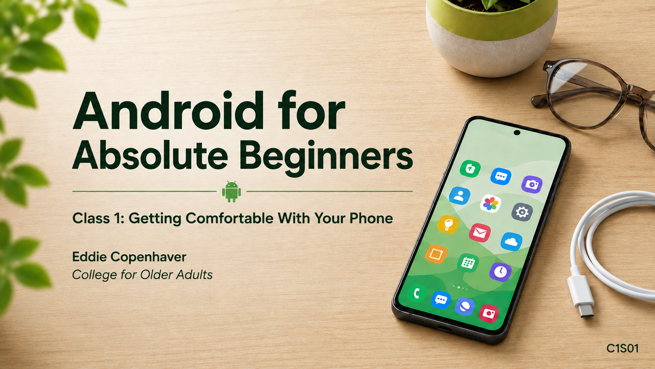
Notes:
Welcome. Set the tone: Android-only, absolute beginners, phones may vary, we will practice.

Slide 2
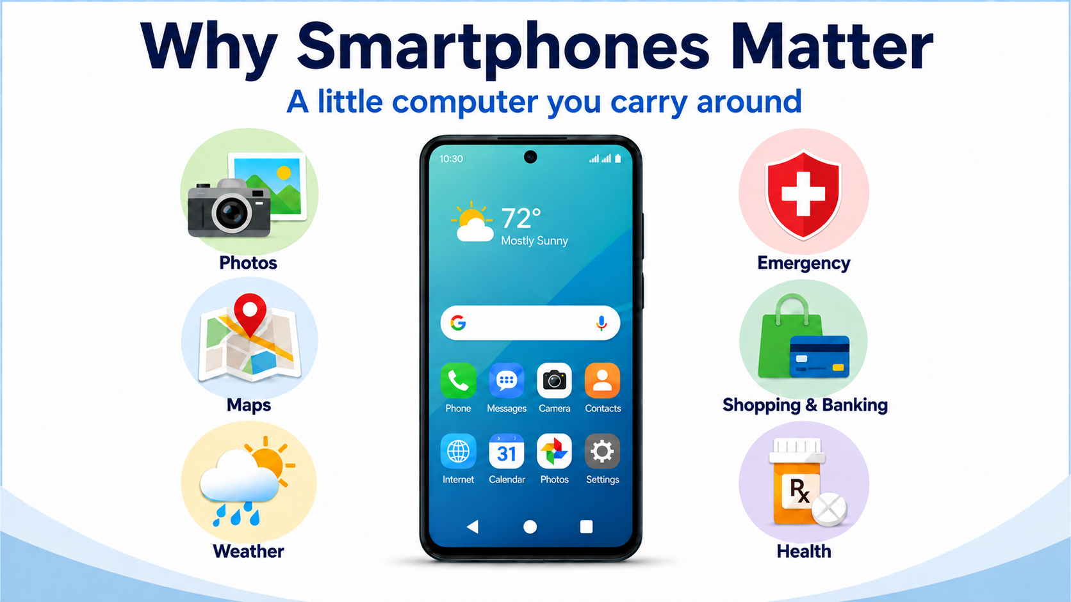
C1S02
Notes:
Talk about maps, rain radar, COA schedule, emergencies — and that nobody has to use every feature. Use the old road map story.

Slide 3
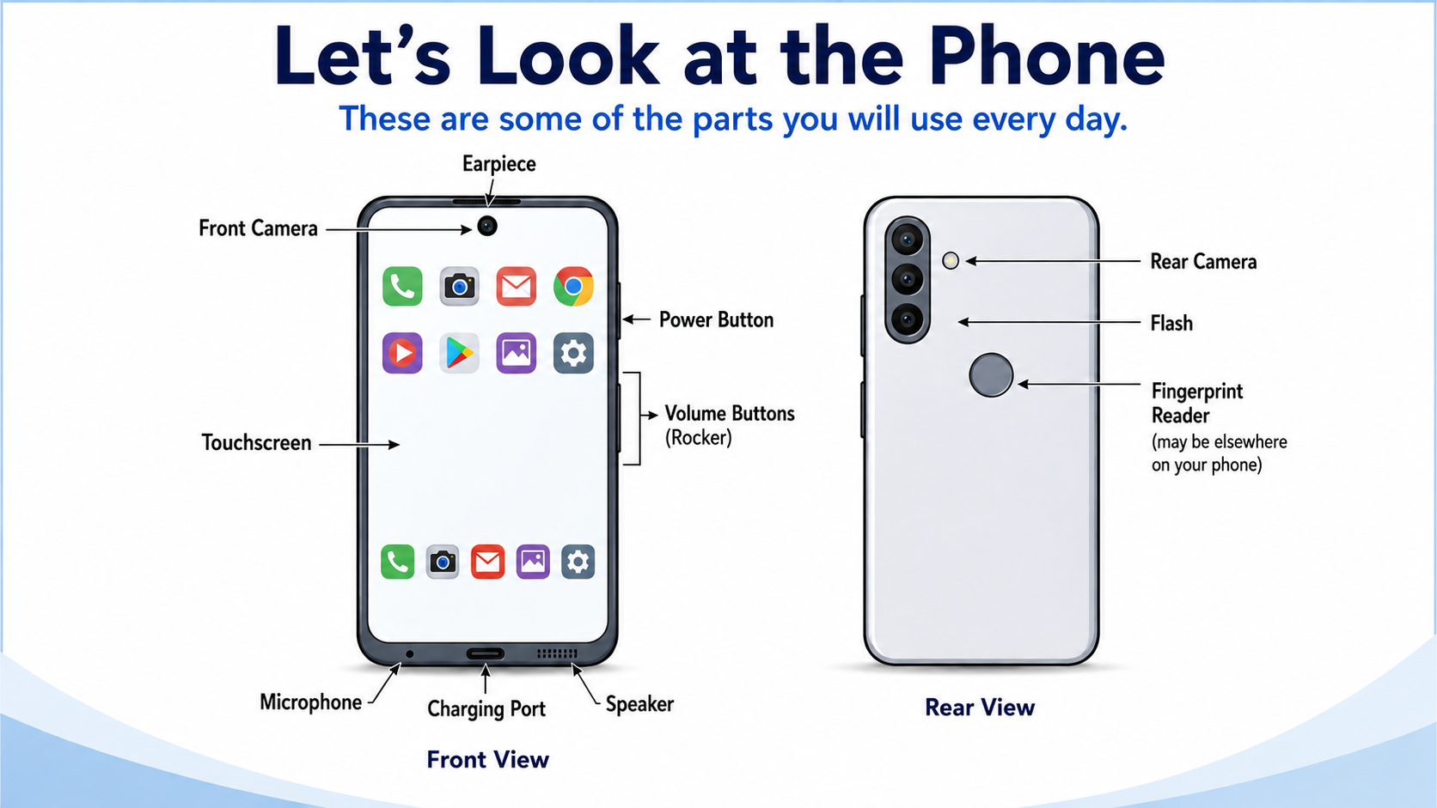
C1S03
Notes:
Have them feel along the side of their own phone and find the buttons before pressing anything. Point to power and volume.

Slide 4
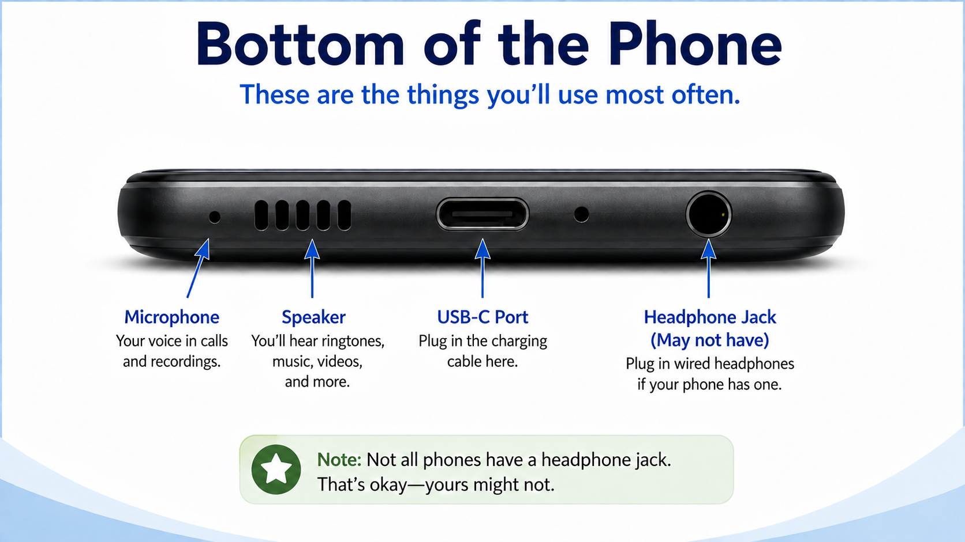
C1S04
Notes:
Say the simple rule: don’t poke things into little holes unless you know what they are for. Mention that ports and locations vary by phone.

Slide 5
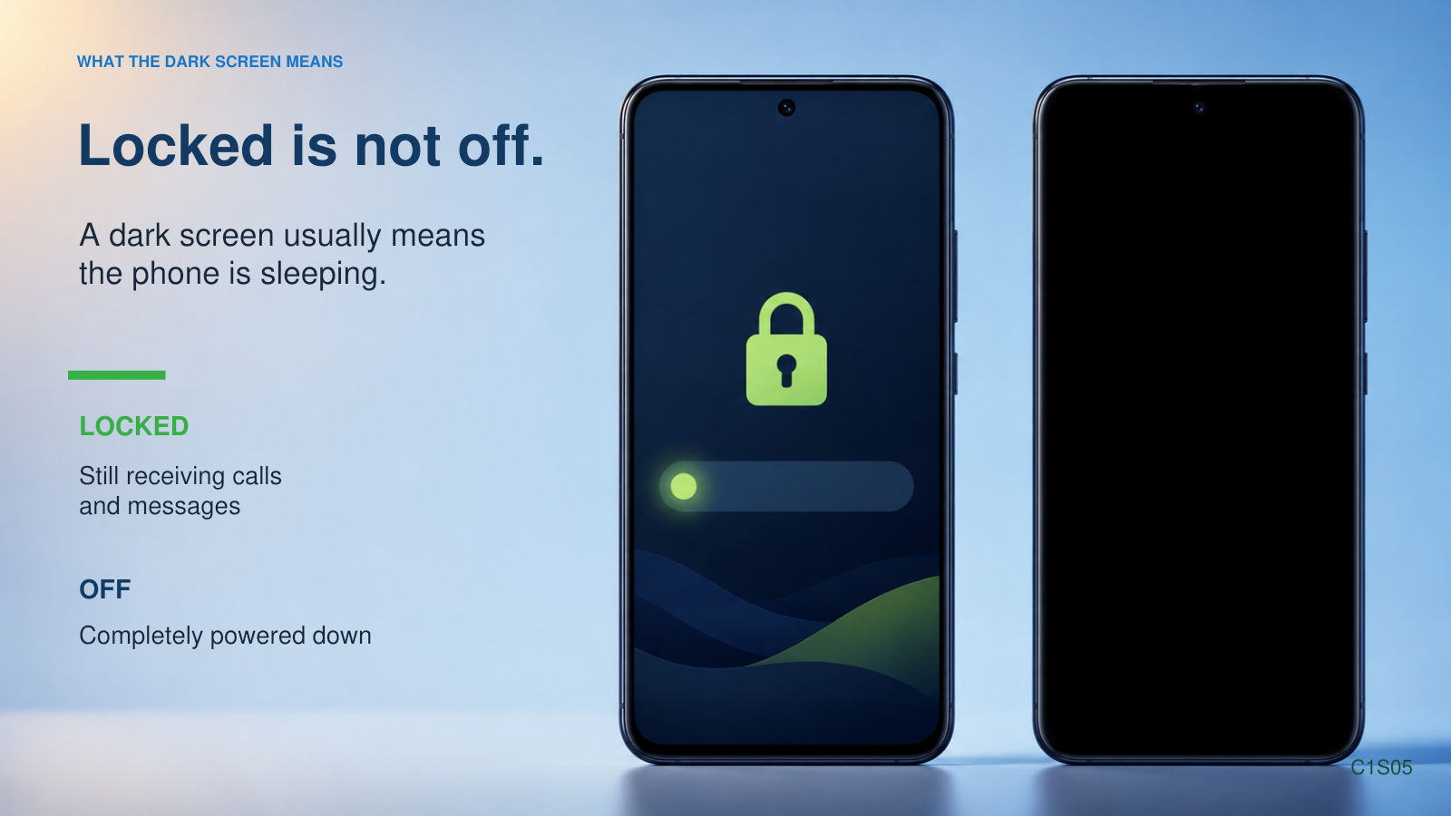
Notes:
Press the power button once. Explain screen timeout. Avoid manufacturer-specific power-off.

Slide 6
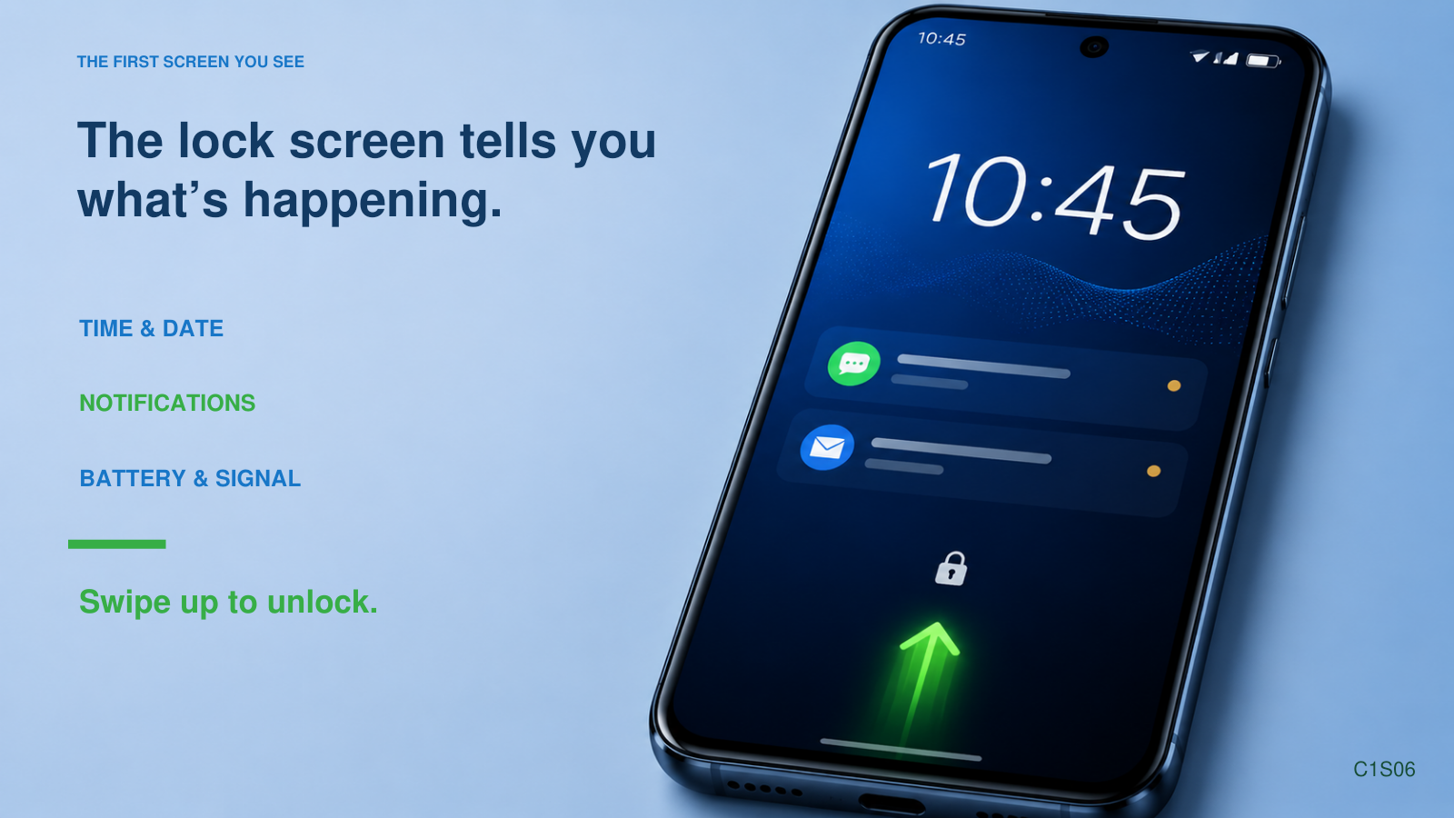
Notes:
Wake the phone. Show that screen-on is not the same as unlocked.

Slide 7
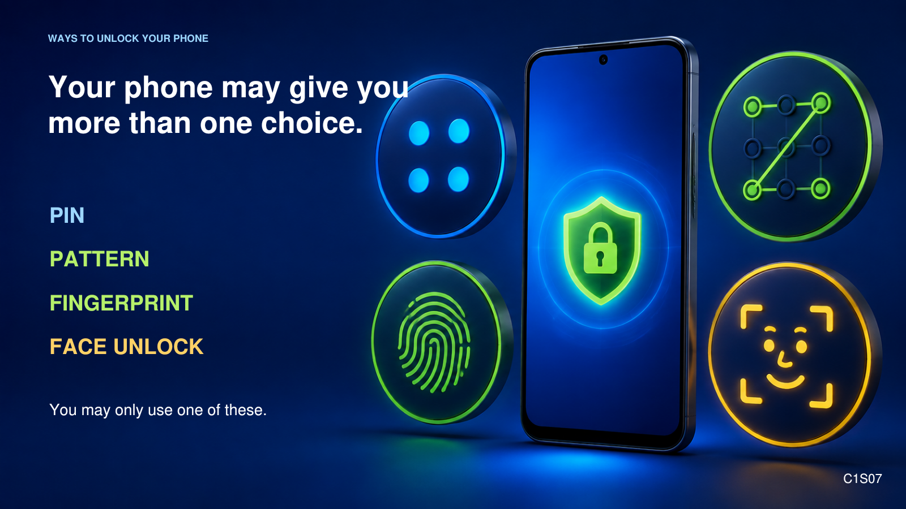
Notes:
Unlock your demo phone. Restart often requires PIN/pattern/password. Do not teach setup today.

Slide 8
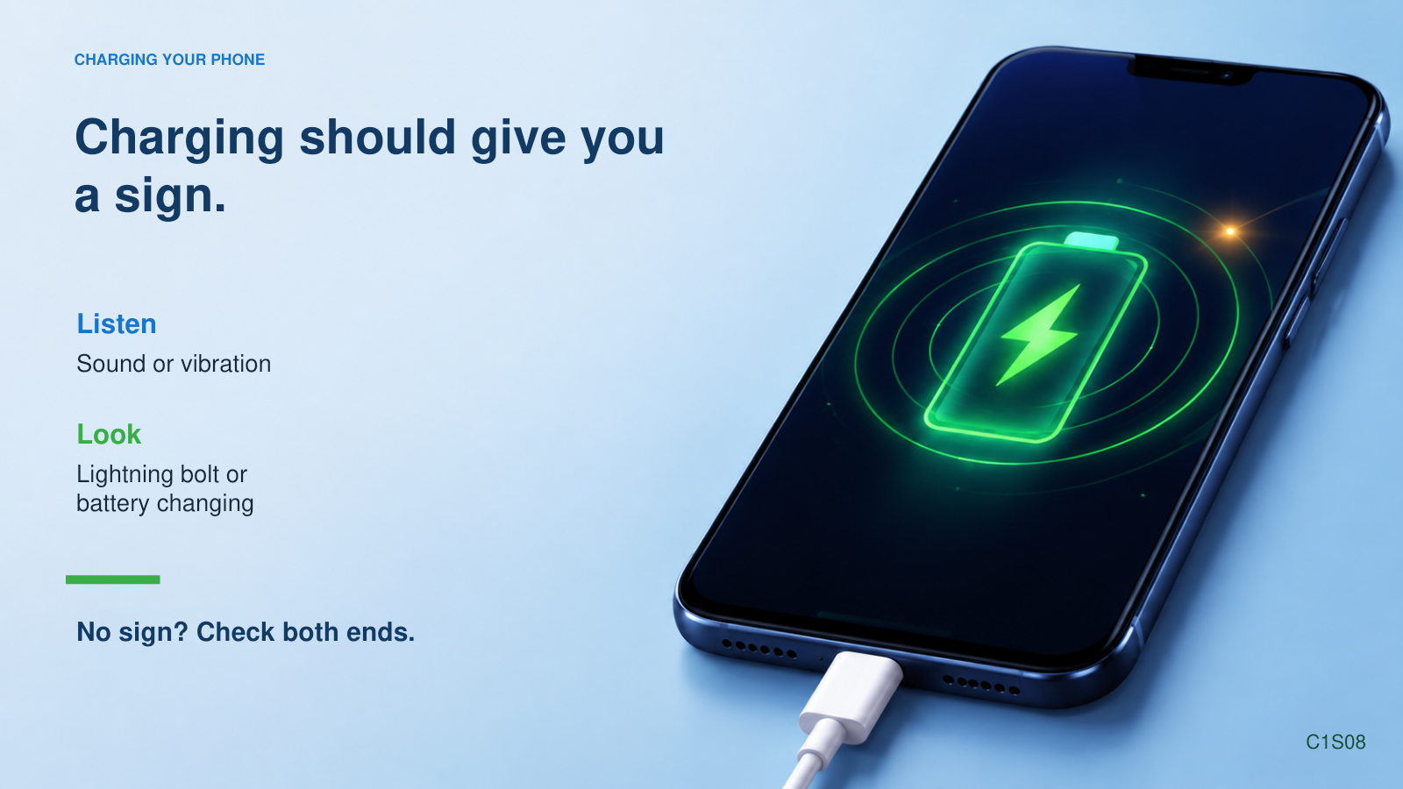
Notes:
Plug in the demo phone and show the charging indicator. No need to fully drain before charging.

Slide 9
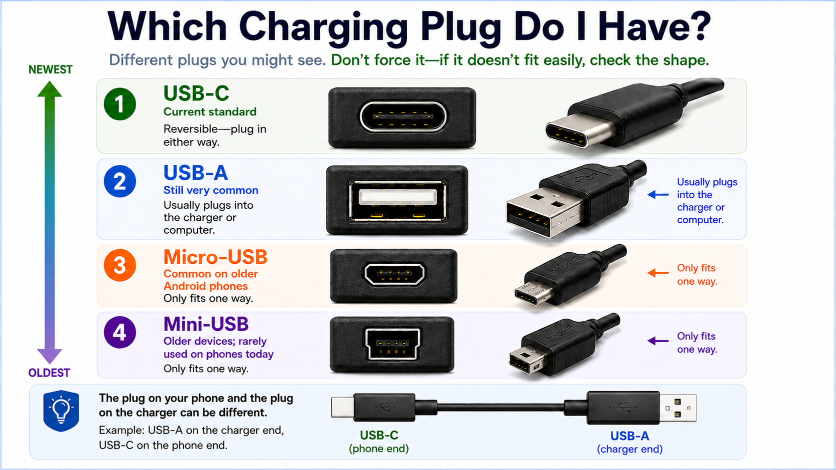
C1S09
Notes:
Hold up real cables. Emphasize: know what fits your own phone. USB-C usually works either way up.

Slide 10
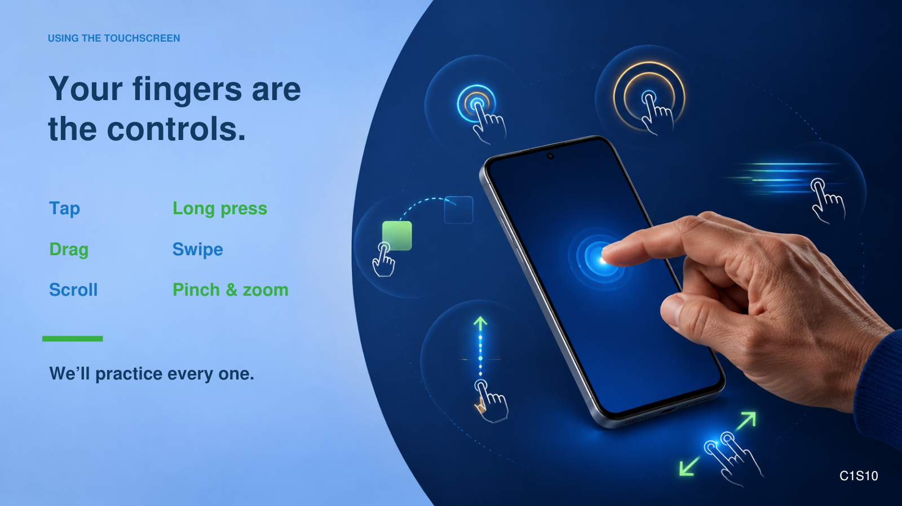
Notes:
A light touch is enough. The phone is looking for touch, not strength.

Slide 11
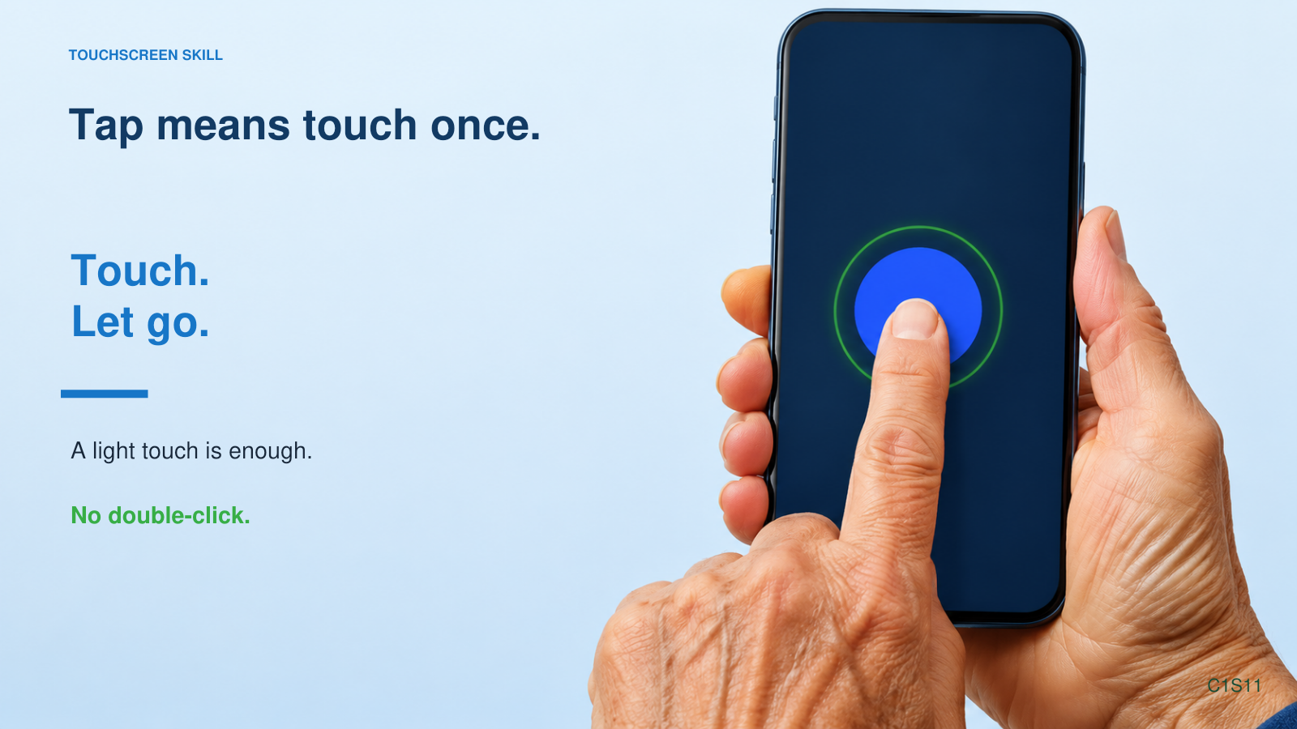
Notes:
Tap an app icon once, then return Home.

Slide 12
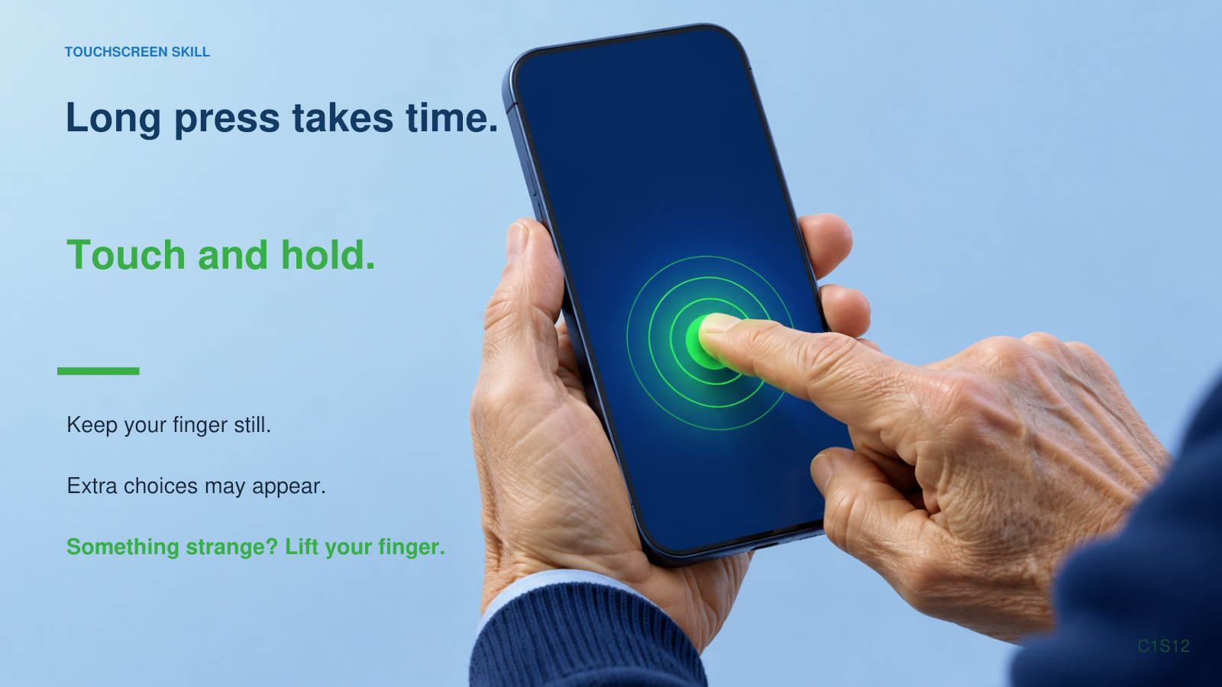
Notes:
Long press a harmless item, then show Back or Home as the rescue.

Slide 13
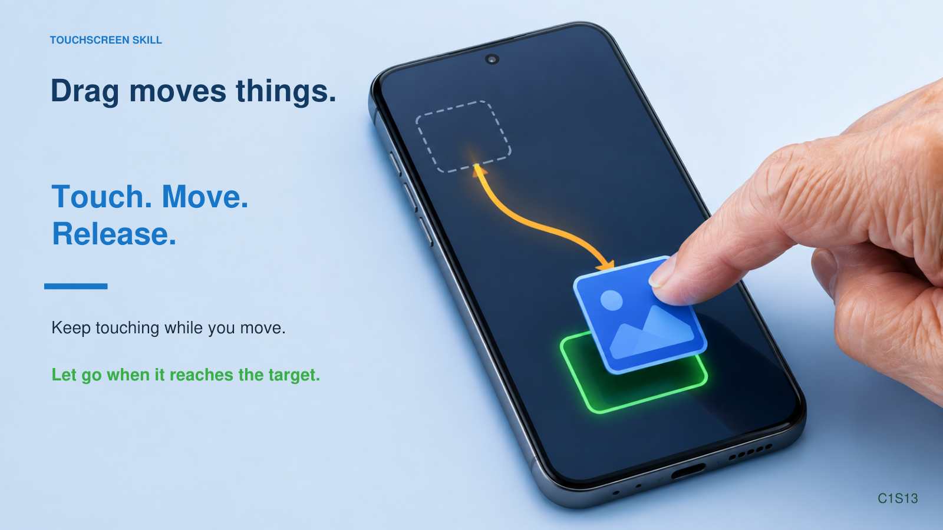
Notes:
Use a safe practice example; emphasize release at the end.

Slide 14
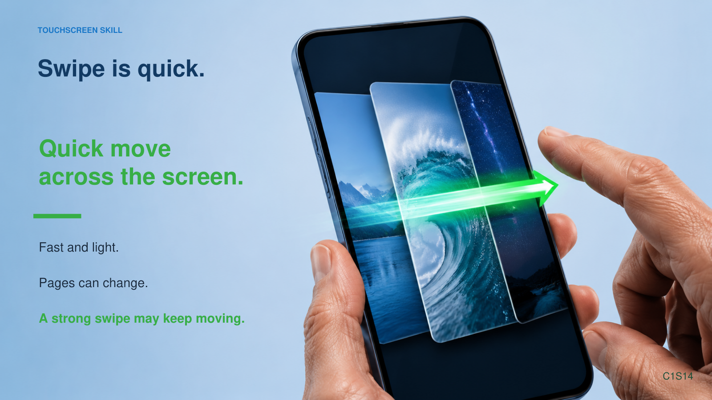
Notes:
Swipe between Home screen pages. Let them see the motion.

Slide 15
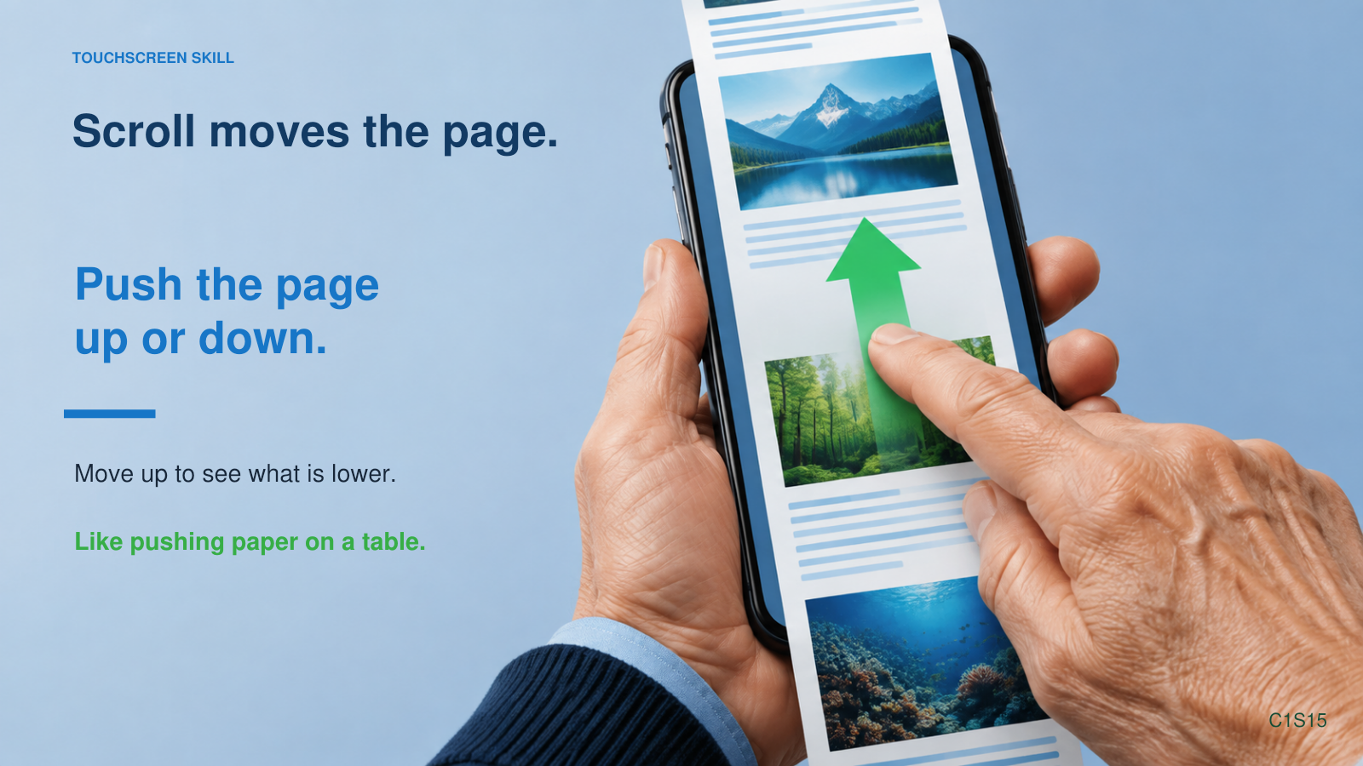
Notes:
Open a long page or Settings list and scroll slowly.

Slide 16
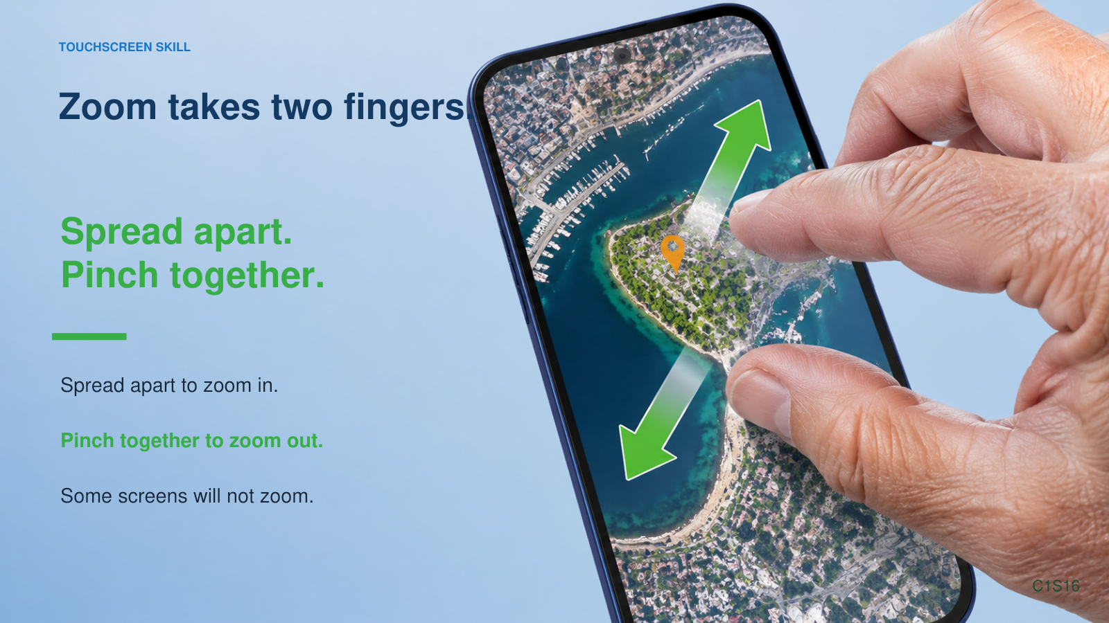
Notes:
Use a map or photo. Show both spread and pinch.

Slide 17
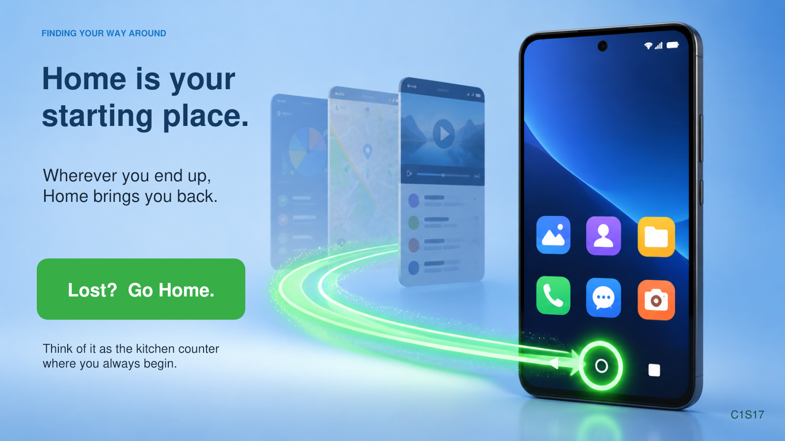
Notes:
Reassure: small text is fixable, just not today’s main lesson.

Slide 18
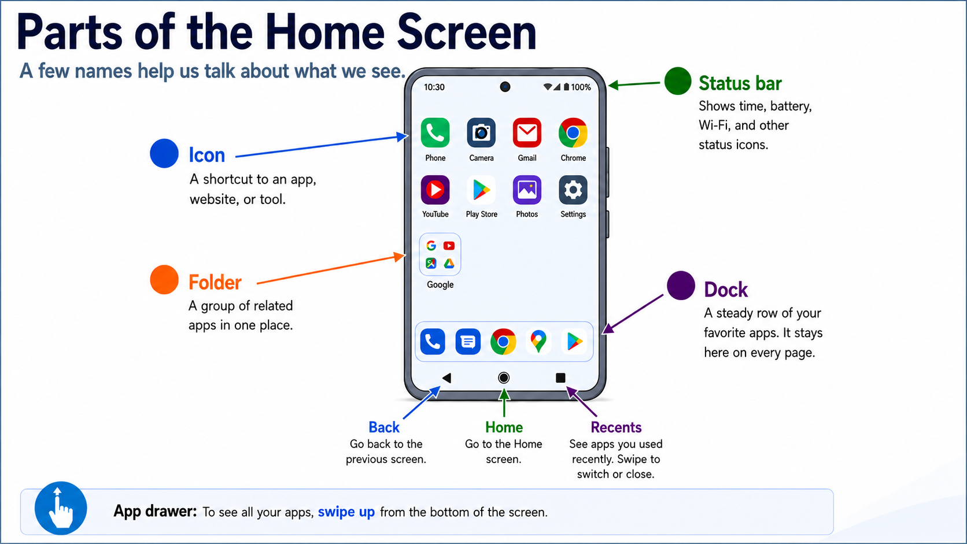
C1S18
Notes:
Point out each part on your phone. Dock = favorites. Folder = drawer. App drawer = pantry.

Slide 19

THREE WAYS TO FIND YOUR WAY
Home, Back, and
Recent Apps
●
HOME
Return to your starting screen
◀
BACK
Go back one step
■
RECENT APPS
See apps you used recently
Your phone may use buttons or gestures.
C1S19
Notes:
Home and Back are the rescue tools. Emphasize Home as best friend.
[Sources]
- Course visual generated with OpenAI image generation, 2026-09-02.
[/Sources]
[Sources]
- Course visual generated with OpenAI image generation, 2026-09-02.
[/Sources]

Slide 20
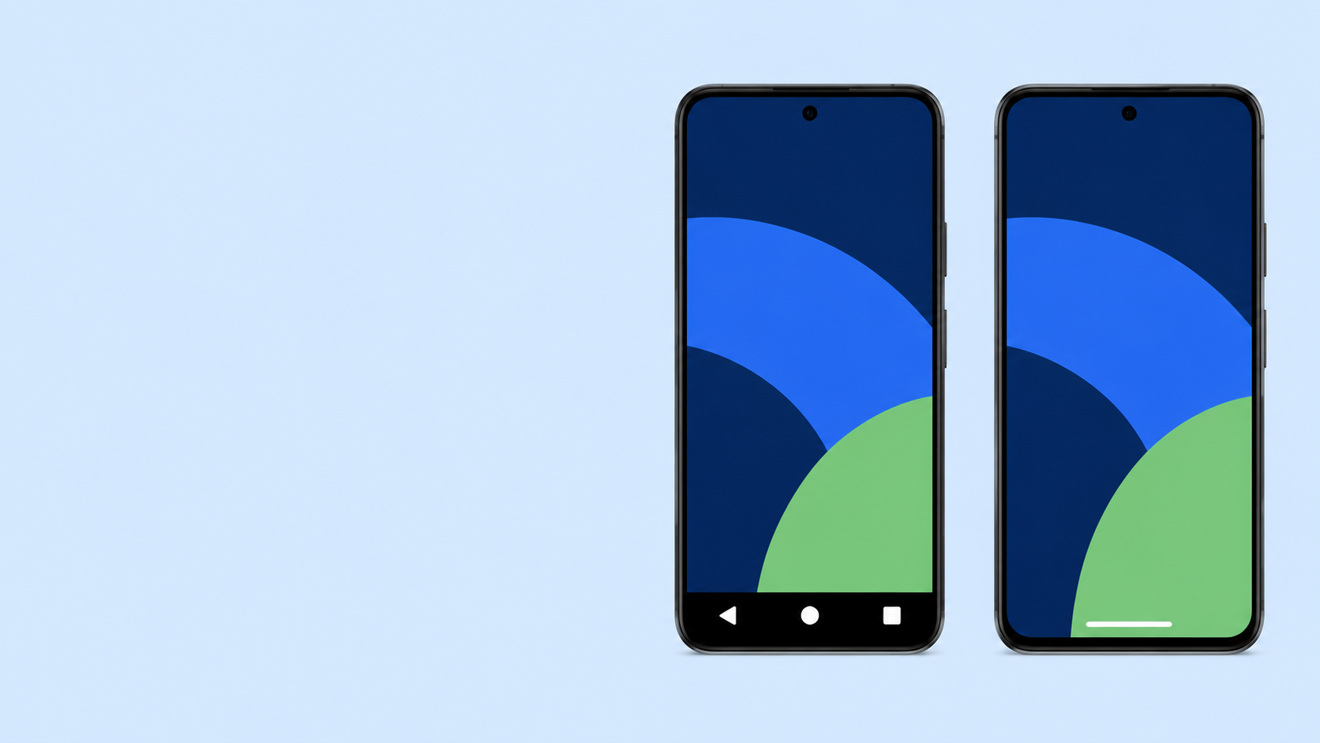
LOOK AT THE BOTTOM OF YOUR SCREEN
Buttons or gestures?
THREE BUTTONS
Triangle • Circle • Square
ONE GESTURE LINE
A short line at the bottom
Both do the same basic jobs.
We are not changing yours today.
C1S20
Notes:
Do a quick visual check. Ask them to notice which one they have.
[Sources]
- Course visual generated with OpenAI image generation, 2026-09-02.
[/Sources]
[Sources]
- Course visual generated with OpenAI image generation, 2026-09-02.
[/Sources]

Slide 21
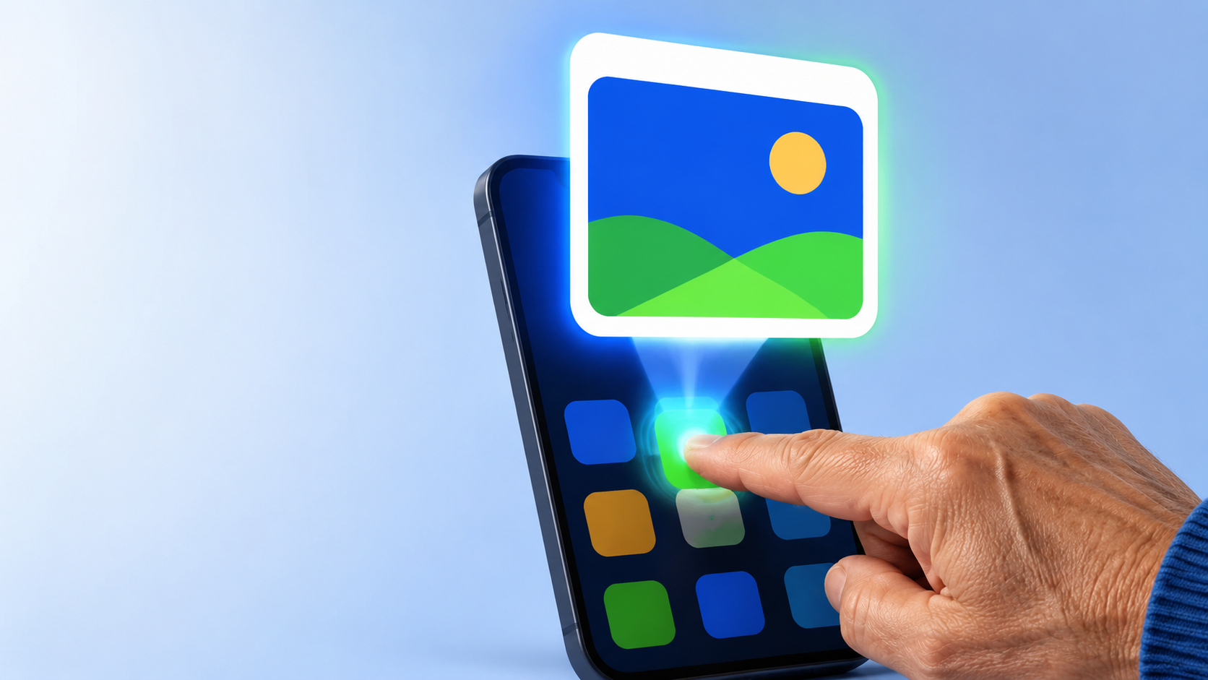
ONE SIMPLE ACTION
Opening an App
Find it. Tap it once.
1
Find the icon
2
Tap it once
3
Look around
Use Home or Back when you’re done.
C1S21
Notes:
Open Camera or another safe app. Then go Home. This is the core loop for lab.
[Sources]
- Course visual generated with OpenAI image generation, 2026-09-02.
[/Sources]
[Sources]
- Course visual generated with OpenAI image generation, 2026-09-02.
[/Sources]

Slide 22
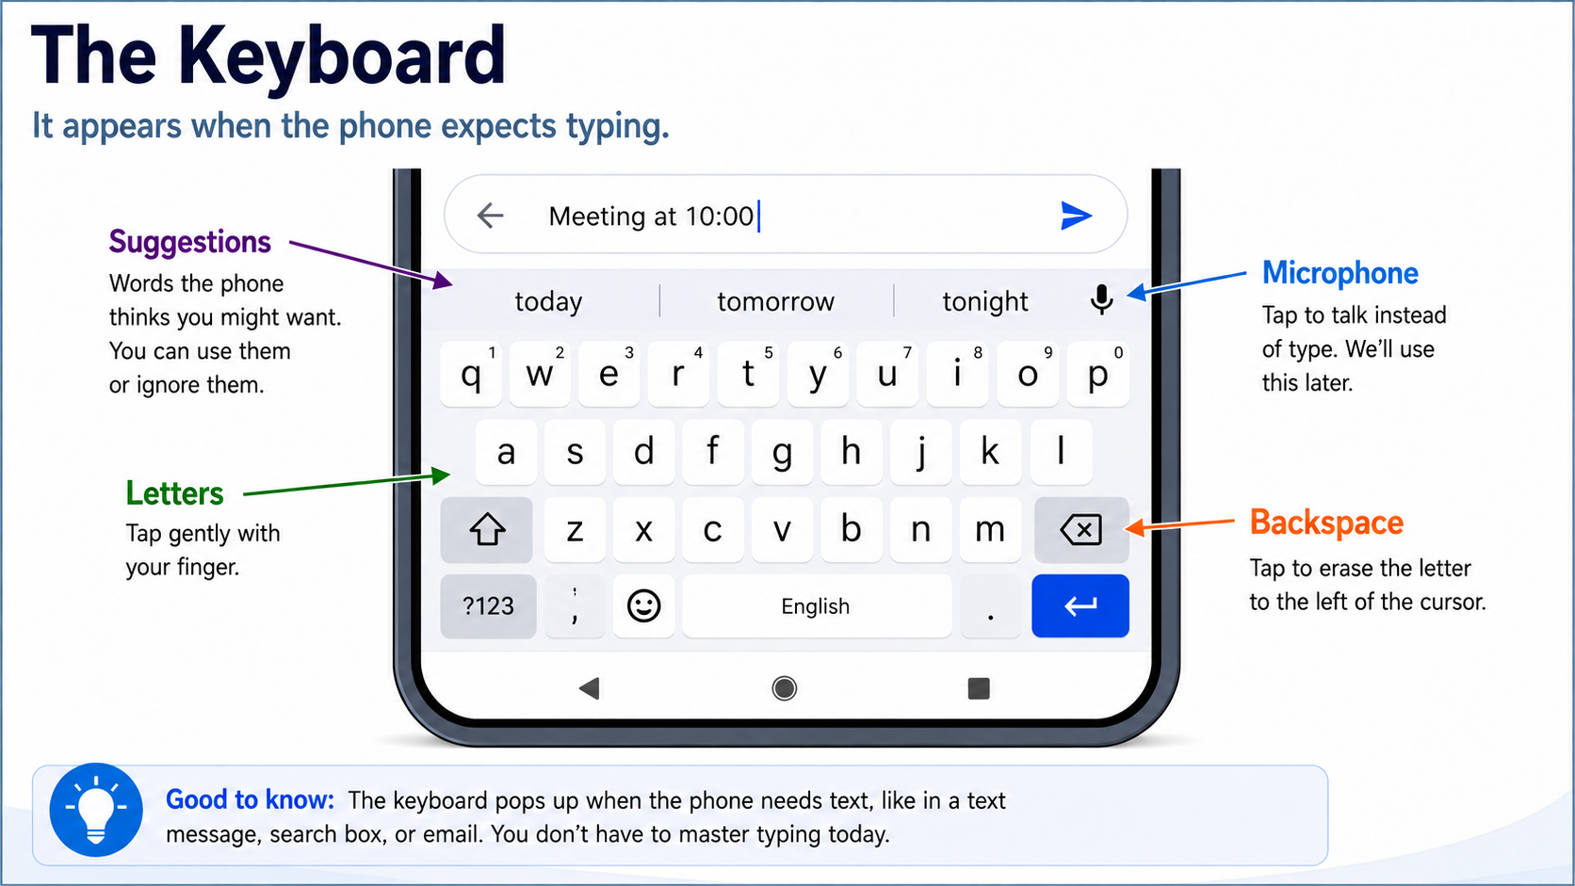
C1S22
Notes:
Use a safe text field. Point out backspace. Mention suggestions can be ignored. Do not try to master typing today.

Slide 23
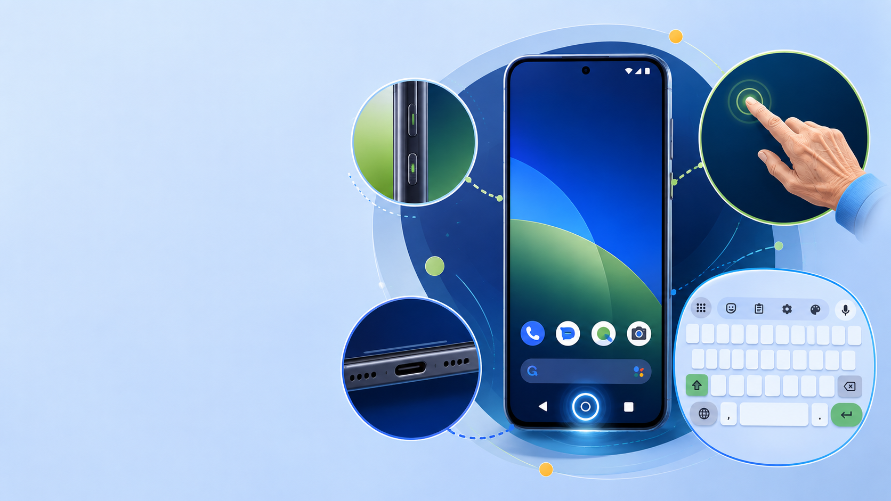
WHAT WE LEARNED TODAY
Look what you learned.
PHONE
Parts • Lock • Charging
TOUCH
Tap • Hold • Drag • Swipe
Scroll • Pinch & zoom
FIND YOUR WAY
Home • Back • Recent apps • Keyboard
C1S23
Notes:
Before lab: if a box pops up and you don’t understand it, stop and ask. Review briefly.
[Sources]
- Course visual generated with OpenAI image generation, 2026-09-02.
[/Sources]
[Sources]
- Course visual generated with OpenAI image generation, 2026-09-02.
[/Sources]

Slide 24
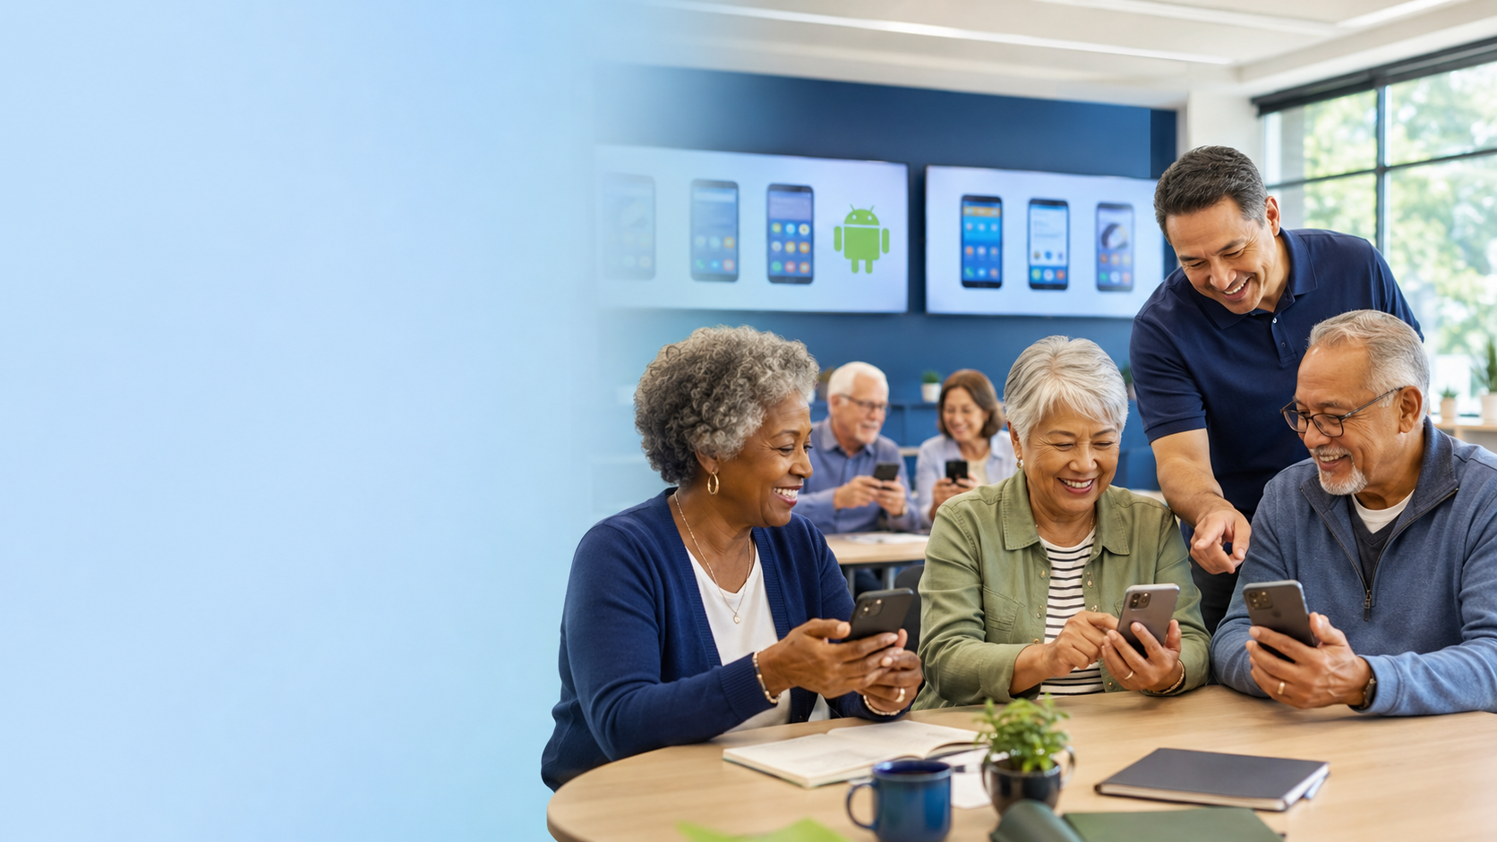
YOUR TURN
Time to practice.
Try the touchscreen skills.
Ask when something surprises you.
Use Back or Home.
You are not expected
to know it yet.
C1S24
Notes:
Take a break, then lab. Circulate and keep the room calm.
[Sources]
- Course visual generated with OpenAI image generation, 2026-09-02.
[/Sources]

