Slide 1
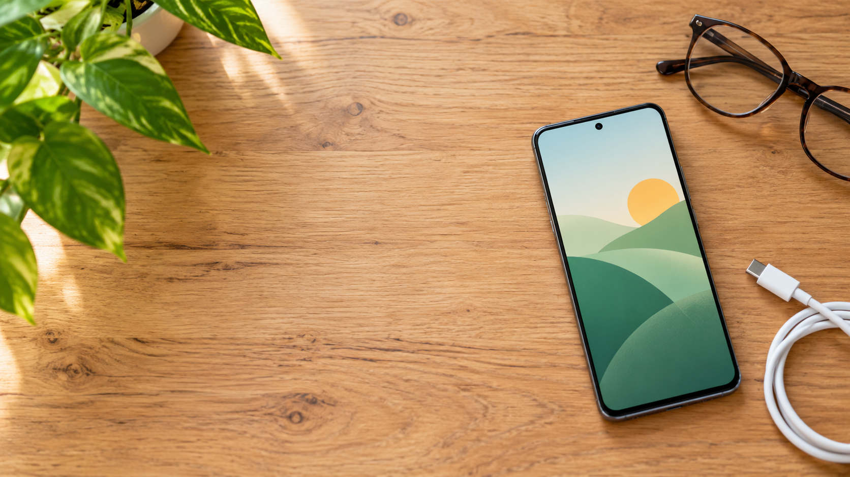

Android for
Absolute Beginners
Class 2: Making Your Phone Work Better for You
Eddie Copenhaver
College for Older Adults
C2S01
Notes:
Welcome back. Briefly reconnect Class 2 to Class 1.
Remind students that Android phones vary, and that they may follow along but should not get stuck during lecture.

Slide 2





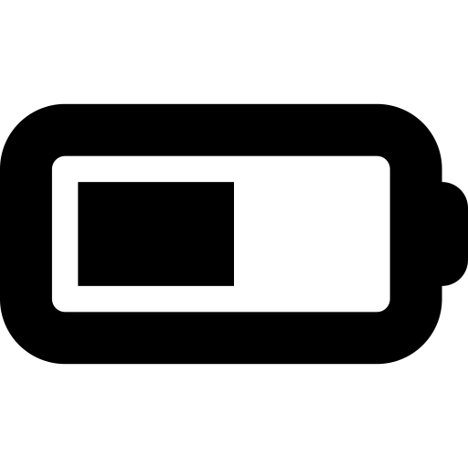

CLASS 2
Today: make the phone work better for you
Settings
Display
Your phone
Notifications
Sound
Connections
Battery
Folders
Watch first. We’ll slow down and practice after the break.
C2S02
Notes:
Use this as the roadmap.
Remind students that button navigation and gesture navigation are both fine.

Slide 3

SETTINGS
Phone Settings and app settings are not the same
Phone Settings
App settings
Affect the phone itself
Affect one particular app
Brightness
Wi‑Fi
Sound
Battery
Text size
Camera choices
Message behavior
App-specific options
Today, when I say “Settings,” I mean the phone’s Settings app.
C2S03
Notes:
Explain that apps are all different.
Notifications are a good example of overlap: an app can have choices, while the phone also controls whether the app may notify.

Slide 4
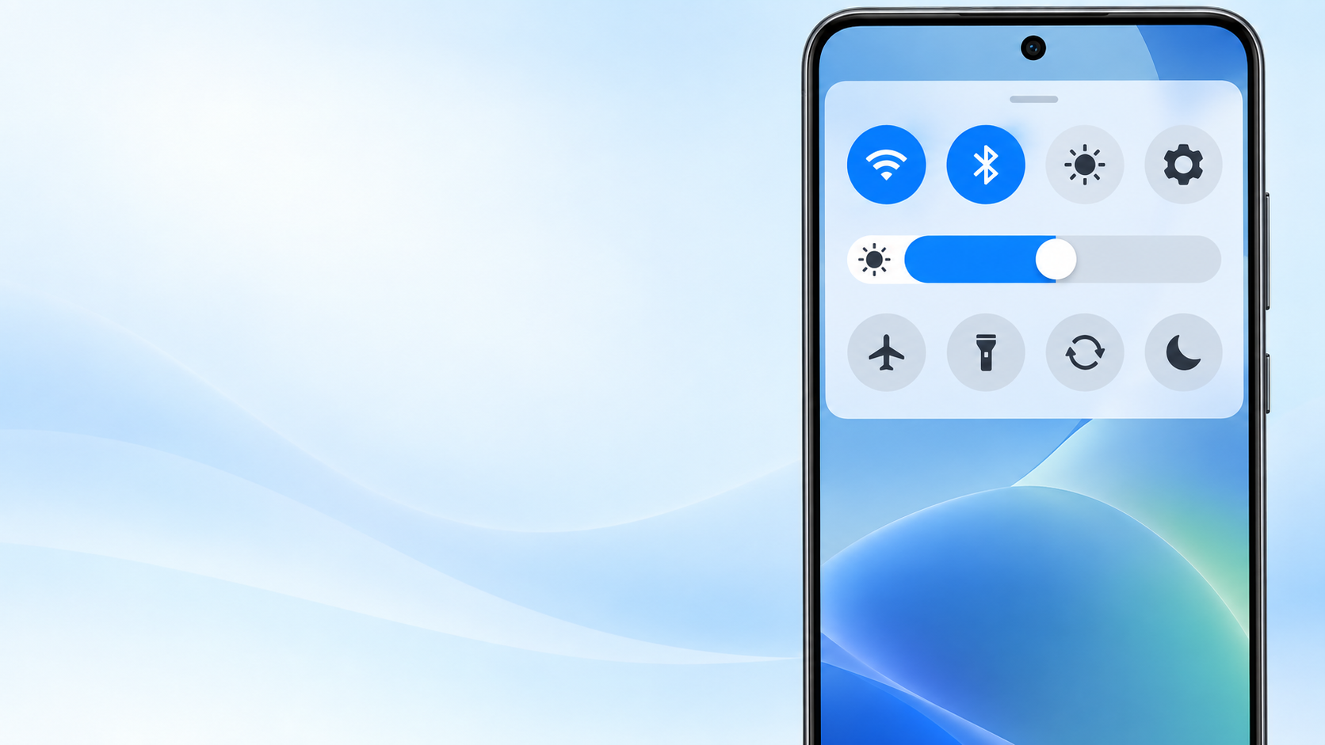
A NAME YOU WILL HEAR
Quick Settings
Swipe down from the top.
Quick Settings gives fast access to things you use often:
Wi‑Fi • Bluetooth
Brightness • Settings gear
You may need to swipe down a second time to see more controls.
C2S04
Notes:
Demonstrate App Drawer → Settings first, then swipe down to show Quick Settings and the gear.
Do not require students to memorize both routes.

Slide 5


DISPLAY
Make the screen comfortable to use
Brightness
Font size
Display size
How bright the
screen looks
How large the
letters appear
How large more
things appear
“I can read that, but I’d rather not squint that hard.”
C2S05
Notes:
Define font briefly: the style or design of the letters.
Demonstrate brightness, font size, and display size.
Point out that apps are all different; larger display/text may fit differently in different apps.

Slide 6

DISPLAY
Portrait or landscape?
Auto‑rotate
Many apps can turn when you turn the phone.
Not every app rotates.
LANDSCAPE
PORTRAIT
C2S06
Notes:
Demonstrate portrait and landscape.
Mention Auto-rotate in Quick Settings if easy to show.
Do not turn this into a class exercise.

Slide 7
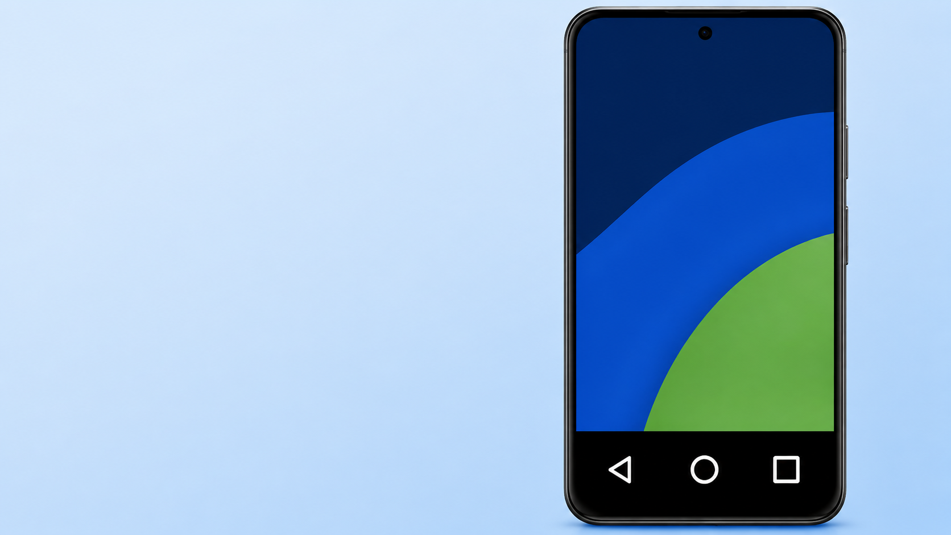

ABOUT PHONE
What phone do I have?
Brand
Model
Android version
Google account
We need the account name — never the password.
C2S07
Notes:
Show About phone for model and Android version.
Explain that manufacturer/brand may not be clearly listed on every phone.
Then show a reliable place to find the Google account name.

Slide 8
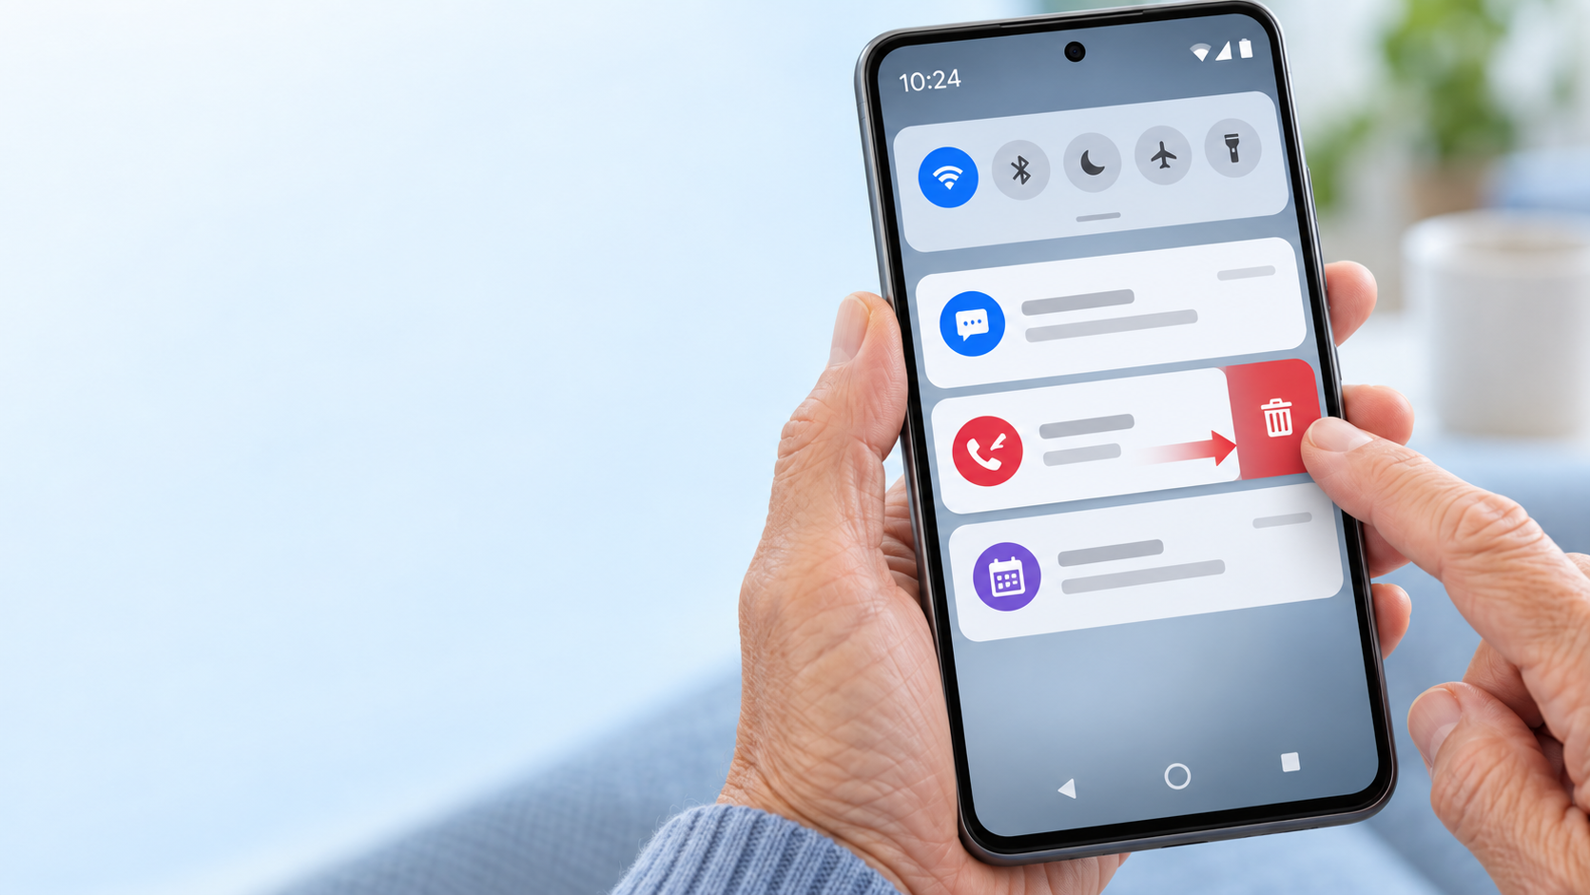




NOTIFICATIONS
Your phone is trying to tell you something
A notification is a message from an app.
Text message
Missed call
Reminder
Weather alert
C2S08
Notes:
Define notification before using the term further.
Point out notification icons in the status bar and that notifications may also appear on the lock screen.

Slide 9



NOTIFICATIONS
Three things you can do
1
2
3
Swipe down
Tap
Swipe sideways
See the notification panel
Open the related app or item
Dismiss the notice
Dismiss removes the notice. It usually does NOT delete the message, email, or missed call behind it.
C2S09
Notes:
Demonstrate the notification panel.
Tap a harmless notification if available, then return.
Dismiss one safe notification and point out Clear all without necessarily using it.

Slide 10
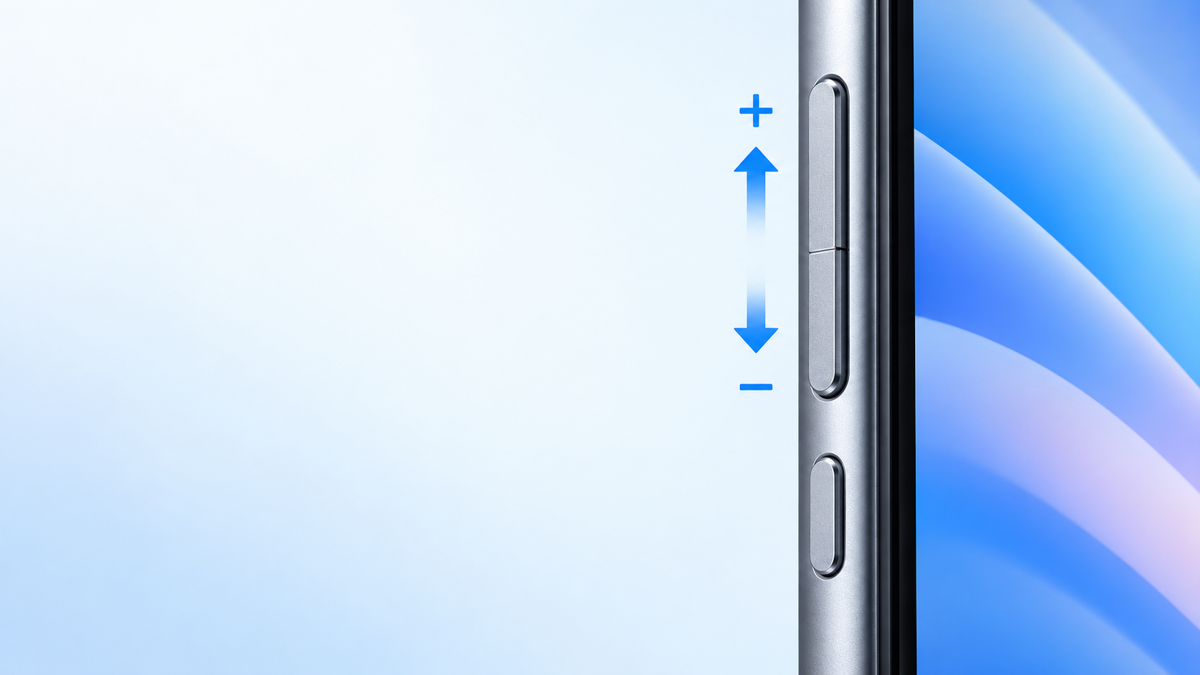
SOUND & VOLUME
The volume rocker is a little see‑saw
Upper end = louder
Lower end = quieter
Your buttons may be on a different side or in a different order than mine.
C2S10
Notes:
Point to the rocker before pressing anything.
Press upper end once, then lower end once.
Use the see-saw analogy because the physical button was confusing in Class 1.

Slide 11


SOUND & VOLUME
Your phone has more than one volume
Media
Calls
Ringtone
Notifications
Alarm
Turning notification sound down does not stop the notification itself.
C2S11
Notes:
Show how to open expanded volume controls: look for three dots, an arrow, sliders, or another small control.
Explain Sound, Vibrate, and Mute.

Slide 12


WIRELESS CONNECTIONS
Three ways your phone communicates
CELLULAR
WI‑FI
BLUETOOTH
Your phone company
A local network
Another nearby device
Works away from home
when you have a cellular signal.
Usually connects your phone
to the Internet through a router.
Headphones • car • speaker
watch • keyboard
Simple rule: Wi‑Fi usually connects to a network. Bluetooth usually connects to a device.
C2S12
Notes:
Describe the Wi‑Fi symbol as a small hand fan or pie slice made of curved sections.
Do not have students disconnect and reconnect to Wi‑Fi.
Mention public Wi‑Fi and cellular-data use briefly.

Slide 13

TWO USEFUL TOOLS
Battery Saver and Settings Search
Battery Saver
Settings Search
Helps the battery last longer
lock screen notifications
It may reduce background activity, dim the screen, or limit some features.
Can’t find a setting? Search for the words you know.
C2S13
Notes:
First use this slide for Battery and Battery Saver.
Later return to the same slide for Settings Search.
Search for “lock screen notifications”; if needed, shorten to “lock screen.”

Slide 14
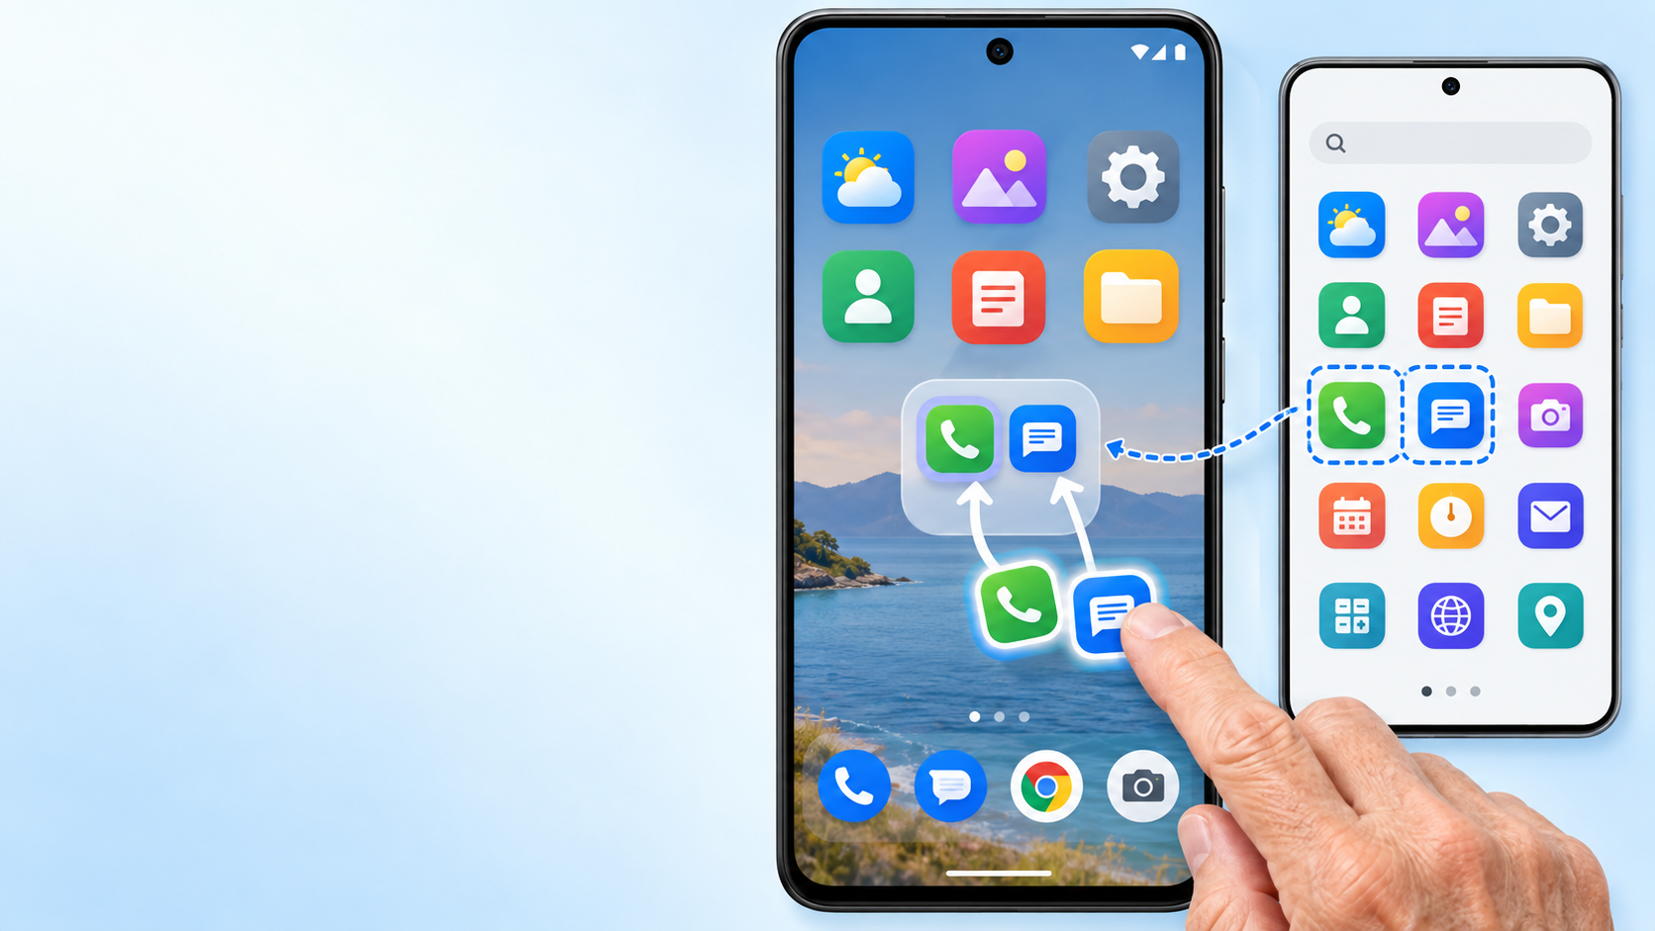
HOME SCREEN
Folders organize — they do not uninstall
1 Drag one app onto another
2 Give the folder a name
3 Remove the folder when you’re done
The apps are still in the App Drawer.
Remove from Home ≠ uninstall from phone
C2S14
Notes:
Demonstrate creating, naming, and removing a folder.
Then open the App Drawer and show that the apps are still there.

Slide 15
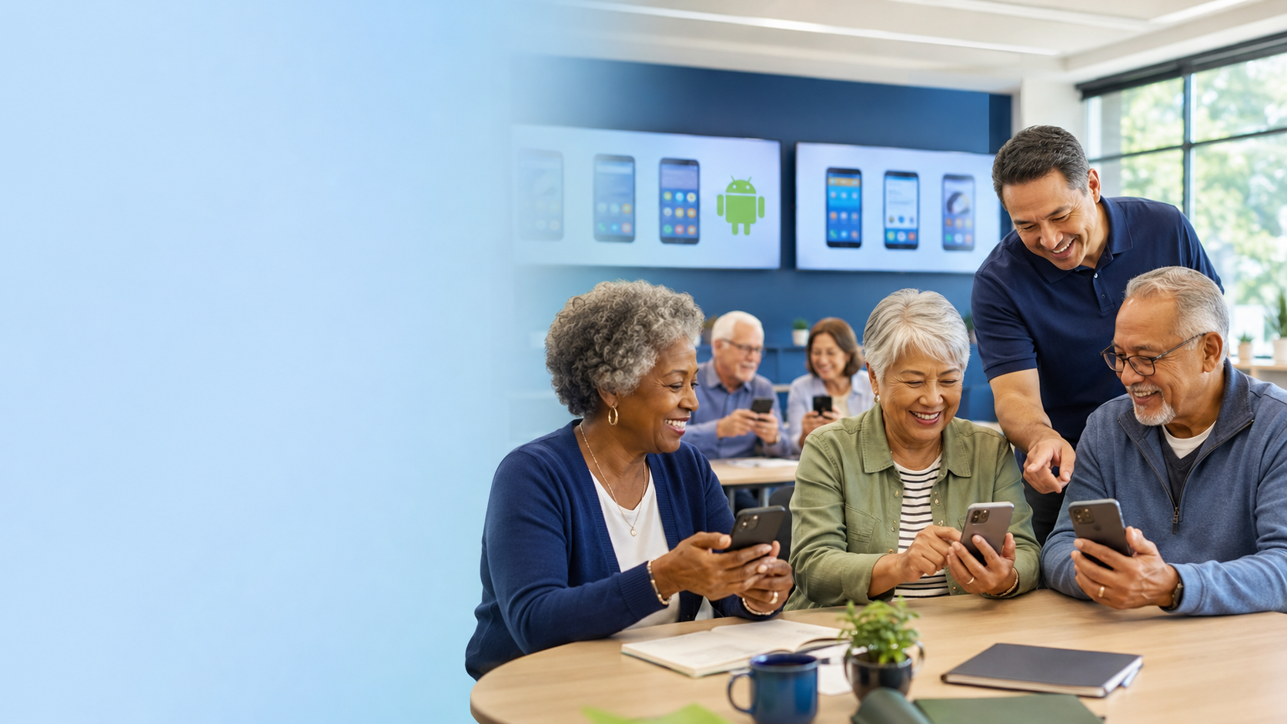
YOUR TURN
After the break, we’ll do it on your phone.
Display
My phone info
Notifications
Battery + Search
Folder
If your phone looks different, that is exactly why we have lab time.
C2S15
Notes:
Take the break, then move into lab.
Students should work on their own phones; troubleshoot differences there rather than during lecture.

