Slide 1

Android for
Absolute Beginners
Welcome to Class 4
Camera and Photos
Eddie Copenhaver
College for Older Adults
C4S01

Slide 2
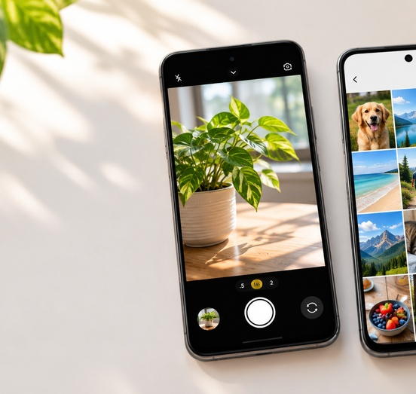
Camera and Photos / Gallery
• Camera = take a new picture or video
• Photos / Gallery = find, view, share, or delete pictures
• If you want an older picture, start in Photos or Gallery
TAKE
FIND
C4S02

Slide 3
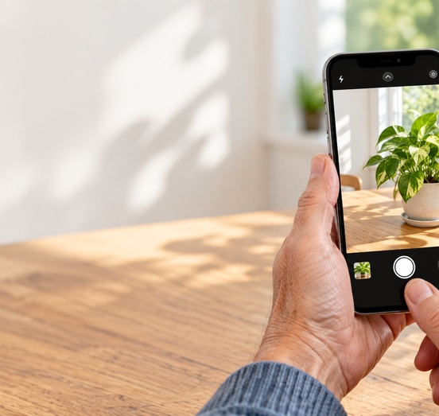
Opening the Camera
• Look for the Camera icon
• It may be on the Home screen or in the App Drawer
• Some phones also have a lock-screen shortcut
C4S03

Slide 4
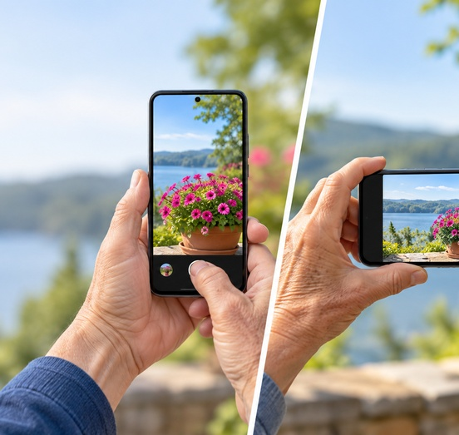
Holding the Phone
• Portrait works well for one person
• Landscape works well for groups or wide scenes
• Hold steady when you tap the shutter
Portrait
Landscape
C4S04

Slide 5
Take a Picture
• Frame what you want to photograph
• Tap the shutter button once
• The phone saves the photo automatically
C4S05

Slide 6
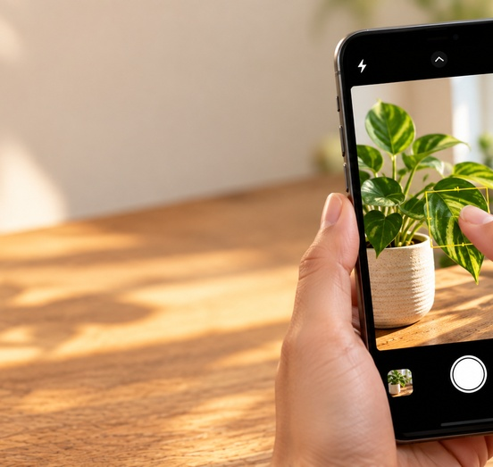
Tap to Focus
• Tap the subject on the screen
• Watch for a box or circle
• Keep the phone still for a sharper picture
C4S06

Slide 7
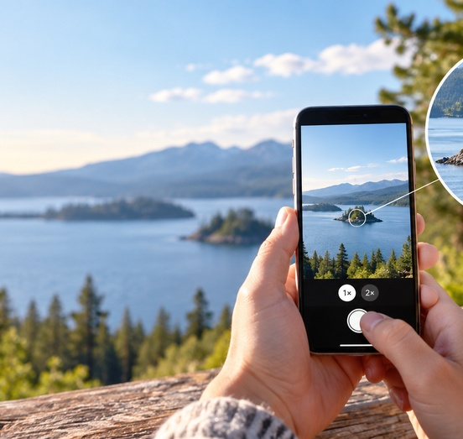
Zoom
• 1x is the normal view
• Zoom only as much as you need
• Often the best zoom is simply walking closer
Use sparingly
C4S07

Slide 8

Front Camera and Rear Camera
• Front camera = selfies and video calls
• Rear camera = other people, pets, places, and objects
• Use the switch-camera button to change
Front
Rear
C4S08

Slide 9
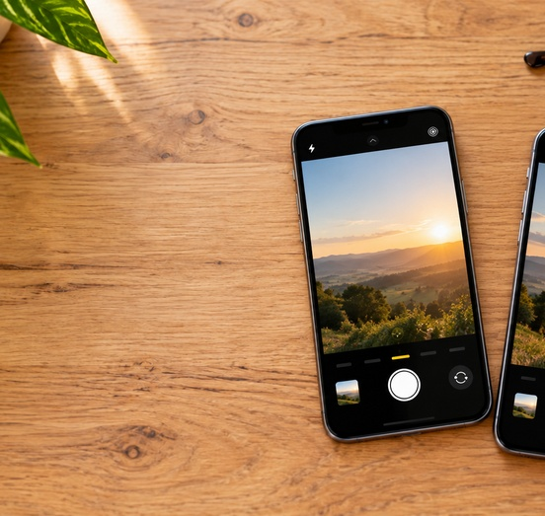
Photo and Video
• Photo captures one moment
• Video records motion and sound
• Short videos are easiest for beginners
Photo
Video
C4S09

Slide 10
Where Did My Picture Go?
• After you take a picture, look for the small thumbnail
• Tap the thumbnail to see the picture you just took
• This is the fastest way to check your last photo
C4S10

Slide 11
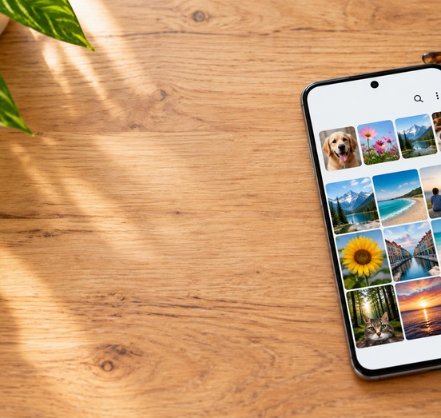
Finding Older Pictures
• Open Photos or Gallery
• Scroll to older pictures
• Swipe left or right to move through photos
C4S11

Slide 12
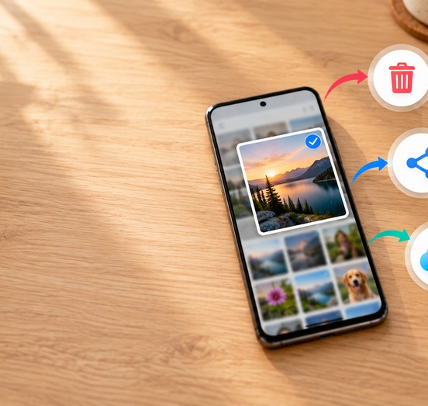
Delete a Picture
• Open the photo you do not want
• Tap the trash can
• Deleted photos may stay in Trash or Bin for a while
Trash / Bin
C4S12

Slide 13
Share a Picture
• Open the photo
• Tap Share
• Choose Messages, Gmail, or another app
Share
C4S13

Slide 14
Check Backup Status
• Do not assume a picture is backed up
• In Google Photos, check the backup status
• Only backed-up photos are protected if the phone is lost
Check first
C4S14

Slide 15
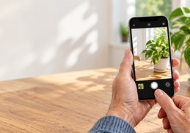
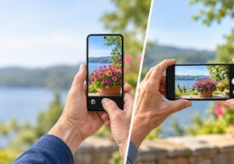

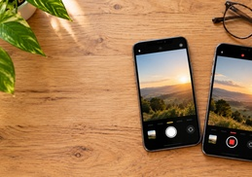
Lab Goals
What students will practice today
✓
Open the Camera
✓
Take a picture
✓
Switch front / rear camera
Practice Time
✓
Record a short video
✓
Find and delete a practice photo
✓
Share one picture
✓
Optional: check backup status
C4S15

