Slide 1
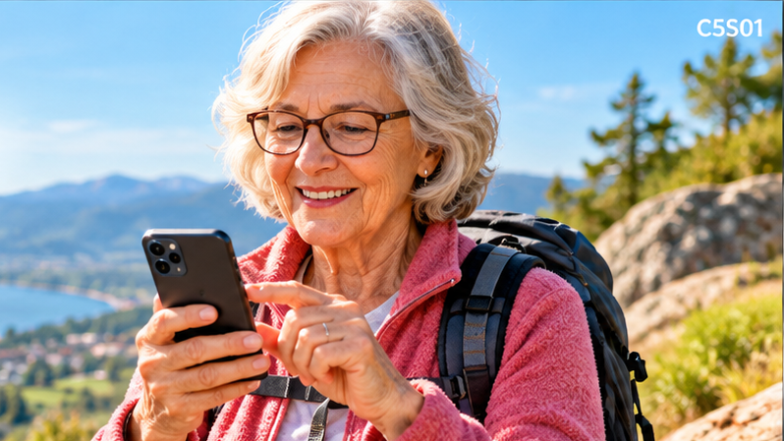
Android for
Absolute Beginners
Welcome to Class 5
Google Maps, Email, and Gemini
Eddie Copenhaver
College for Older Adults
C5S01

Slide 2
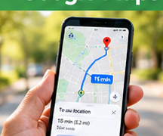


Three Things We'll Learn Today
Google Maps
Email
Gemini
• Find places
• Send messages
• Ask questions
• Get directions
• Attach photographs
• Solve phone problems
• Check traffic
• Stay safe
• Check answers
C5S02

Slide 3
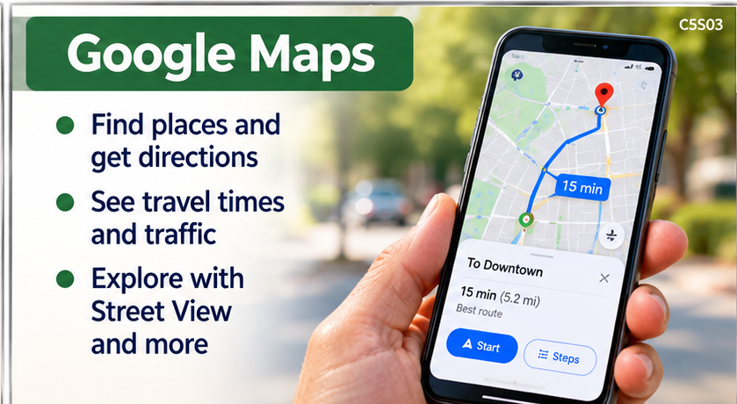
Google Maps
• Find places and get directions
• See travel times and traffic
• Explore with Street View
C5S03

Slide 4
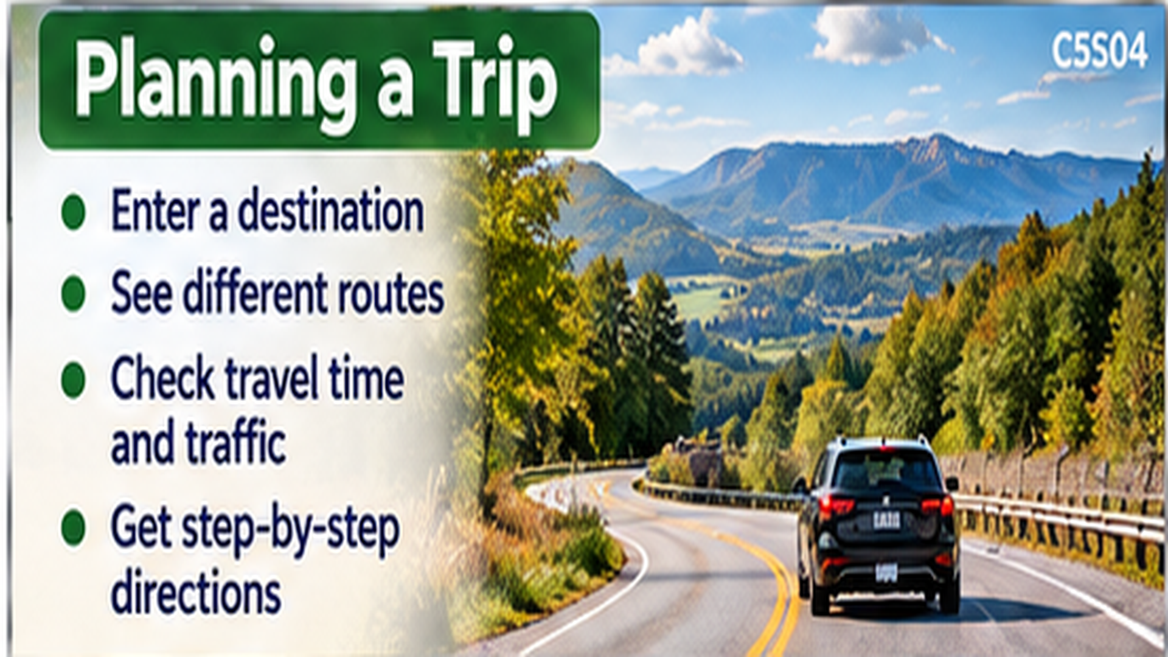
Planning a Trip
• Enter a destination
• Compare routes and travel times
• Check traffic before leaving
• Follow directions safely
C5S04

Slide 5
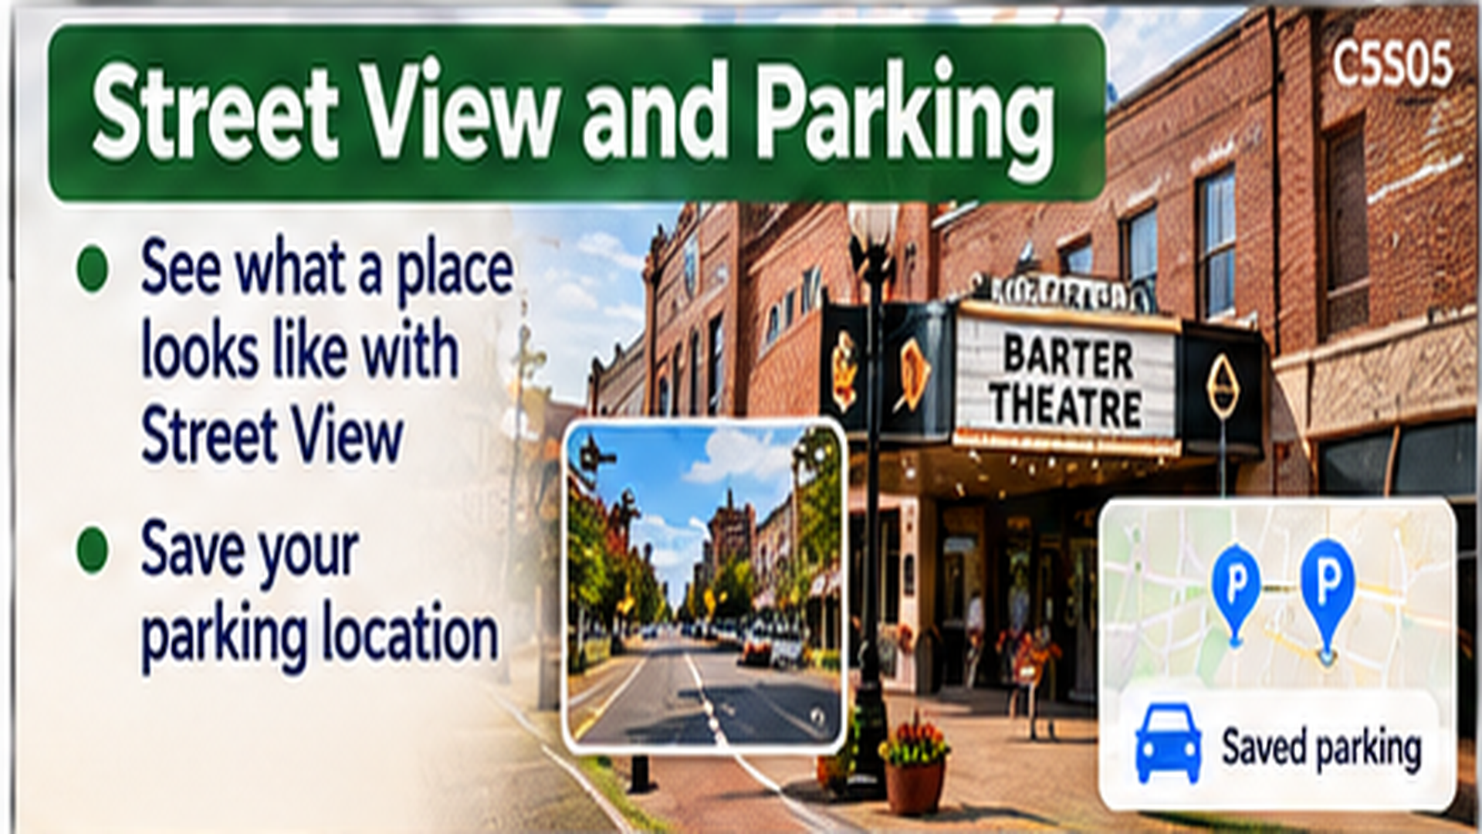

Street View and Parking
• See what a destination looks like
• Explore Barter Theatre in Street View
• Save your parking location
C5S05

Slide 6
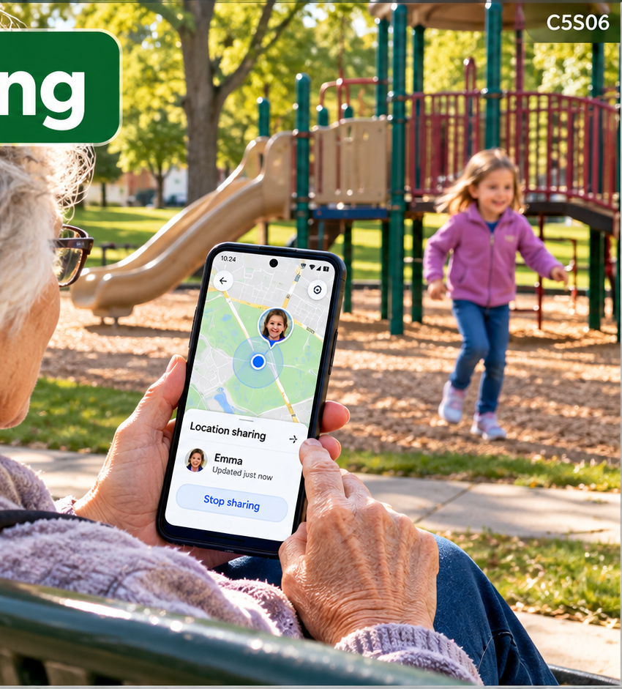
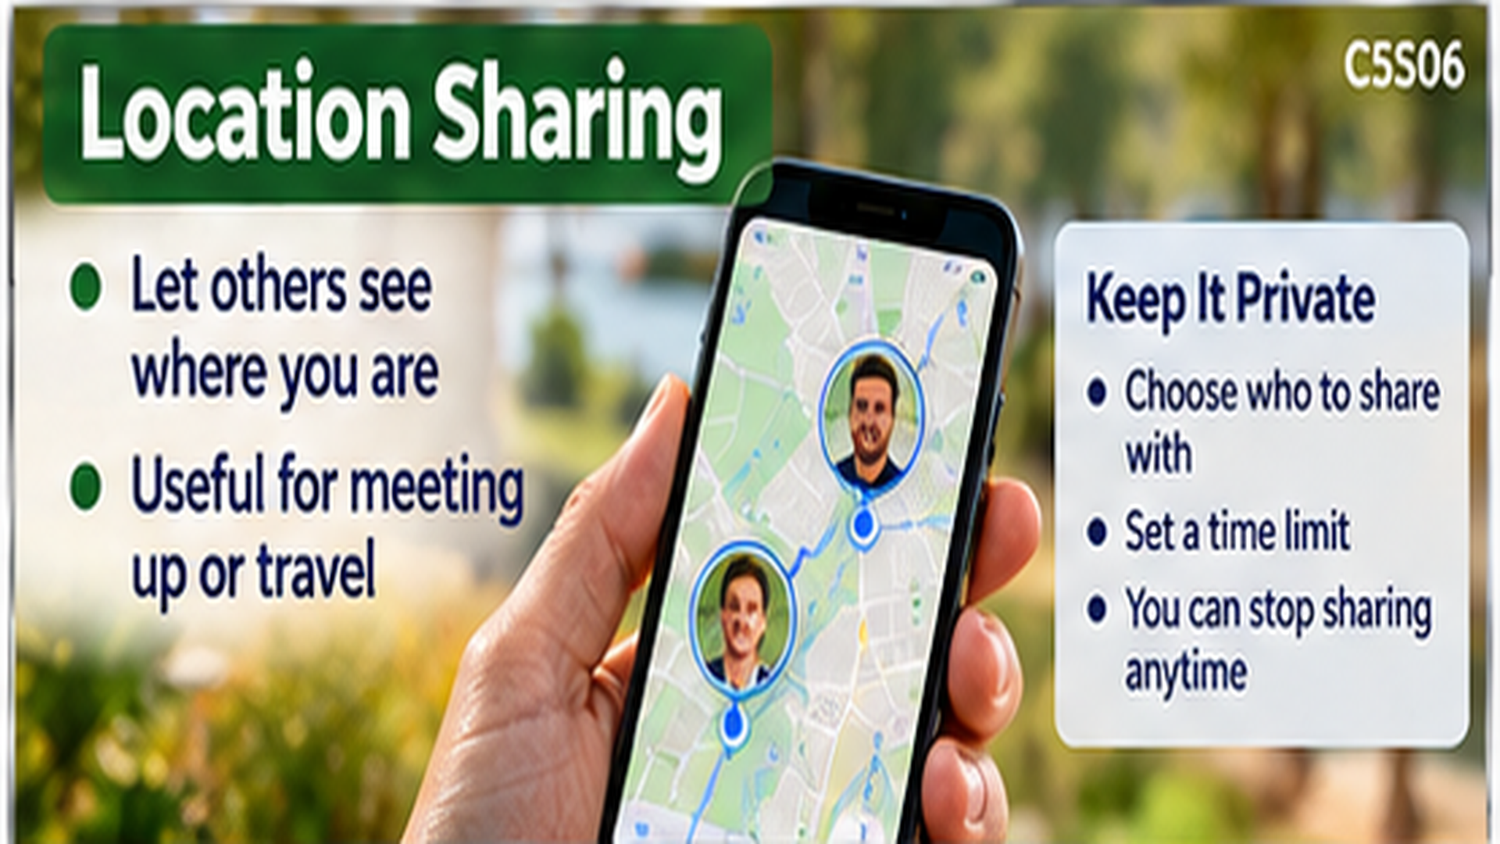
Location Sharing
• Share your location with someone you trust
• Choose how long to share
• Stop sharing when you're done
C5S06

Slide 7
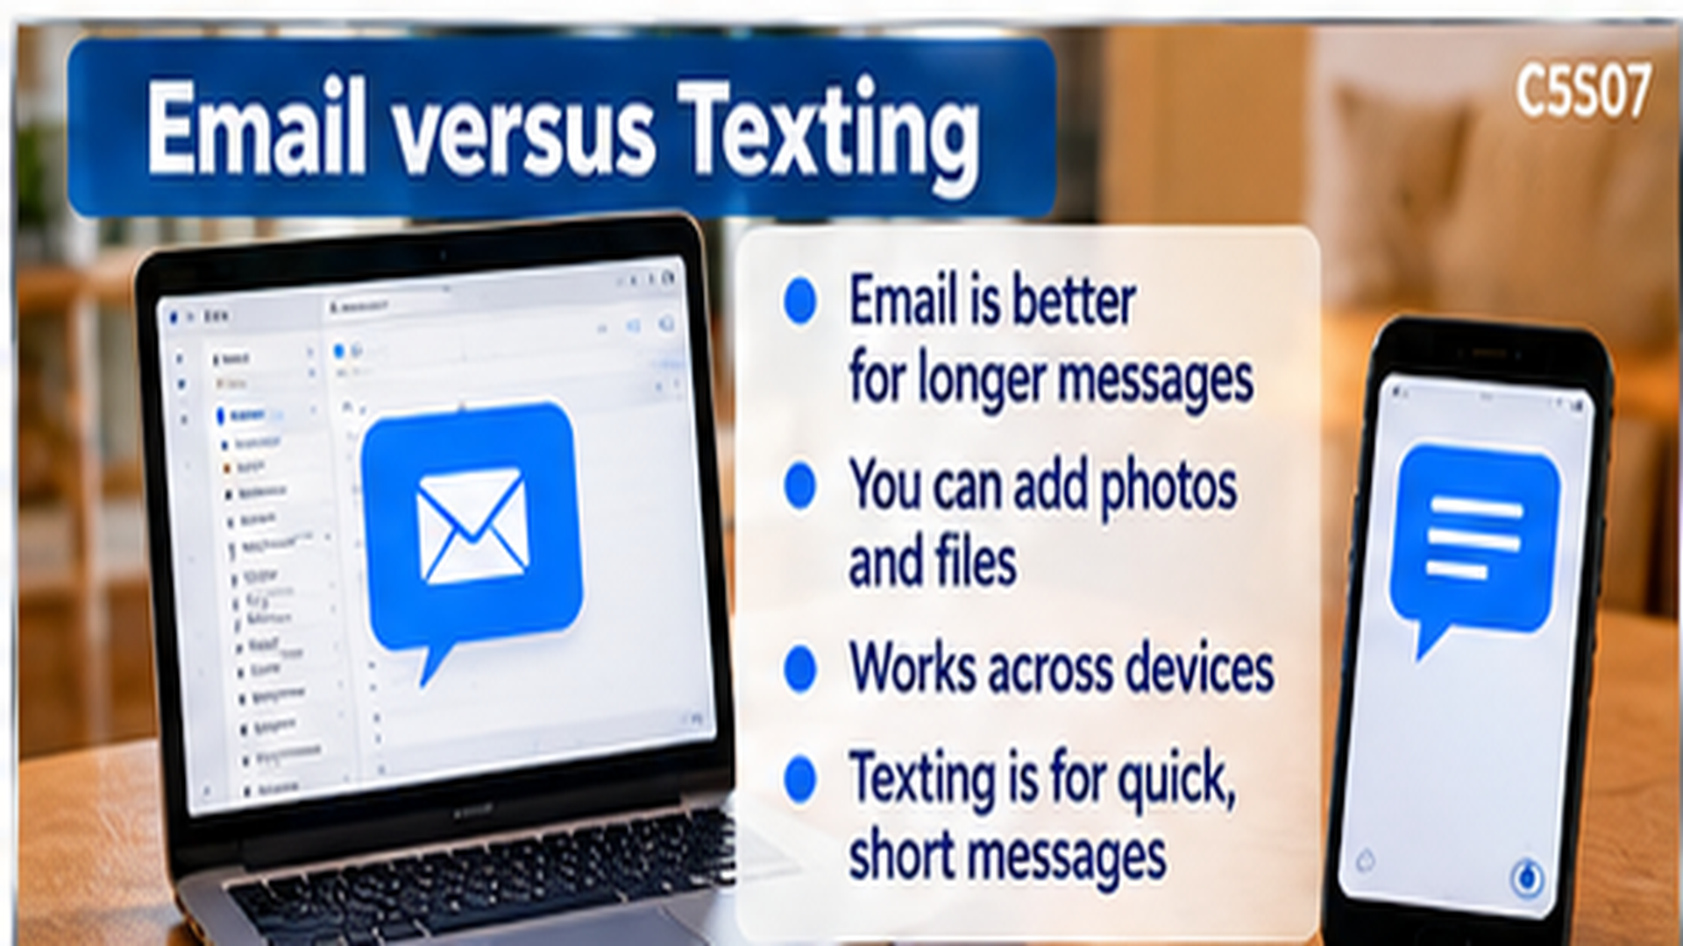
Email versus Texting
• Email uses an email address
• Email is useful for longer messages and files
• Texting is usually quicker for short messages
C5S07

Slide 8
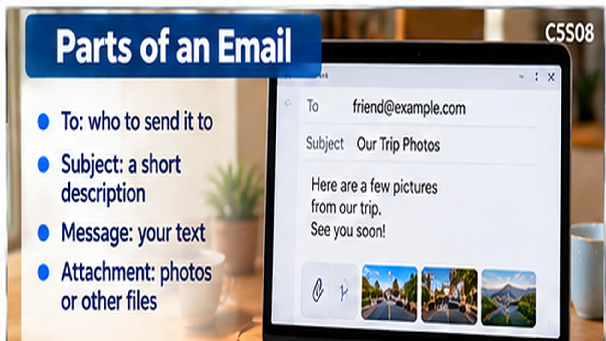
Parts of an Email
• To — who receives it
• Subject — what it's about
• Message — what you want to say
• Attachment — a photo or file
C5S08

Slide 9
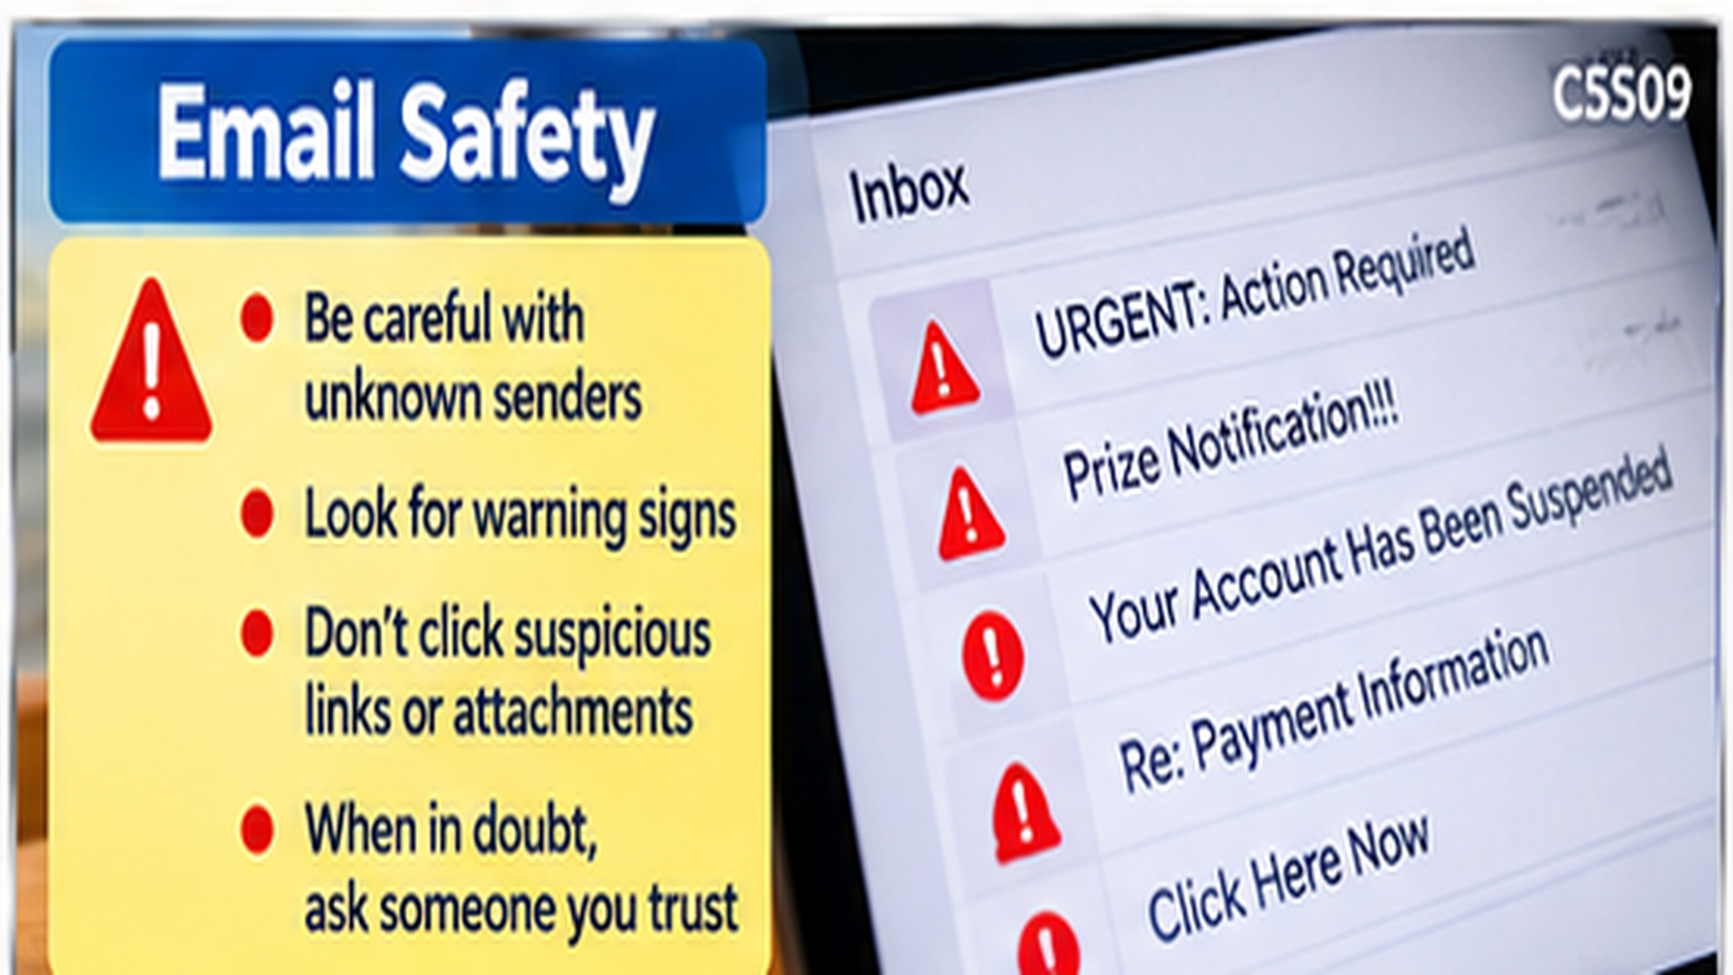
Email Safety
• Be cautious with unknown senders
• Don't click suspicious links
• Never send passwords by email
C5S09

Slide 10
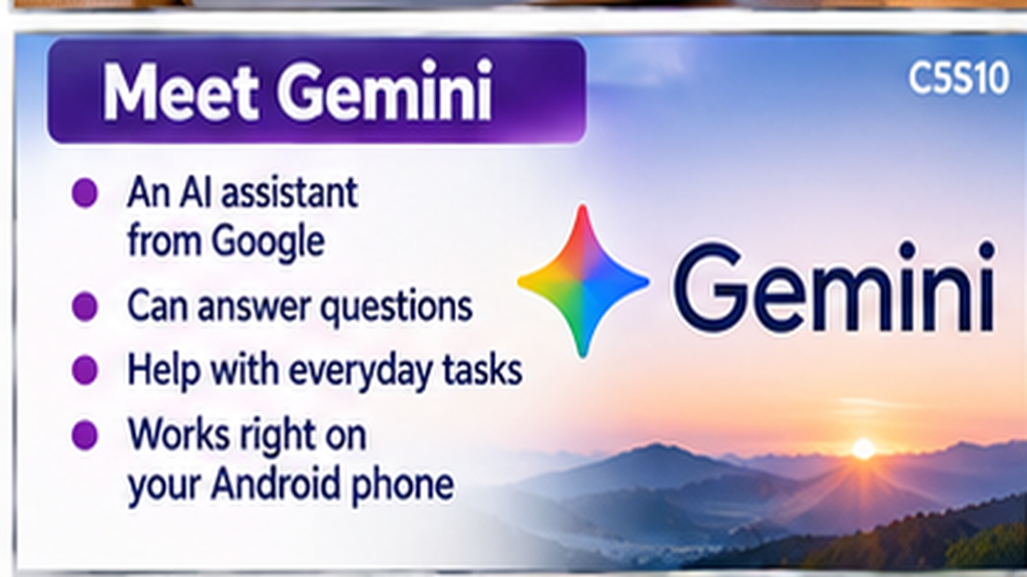
Meet Gemini
• Google's conversational AI assistant
• Ask questions in everyday language
• Use it to learn about your own phone
C5S10

Slide 11
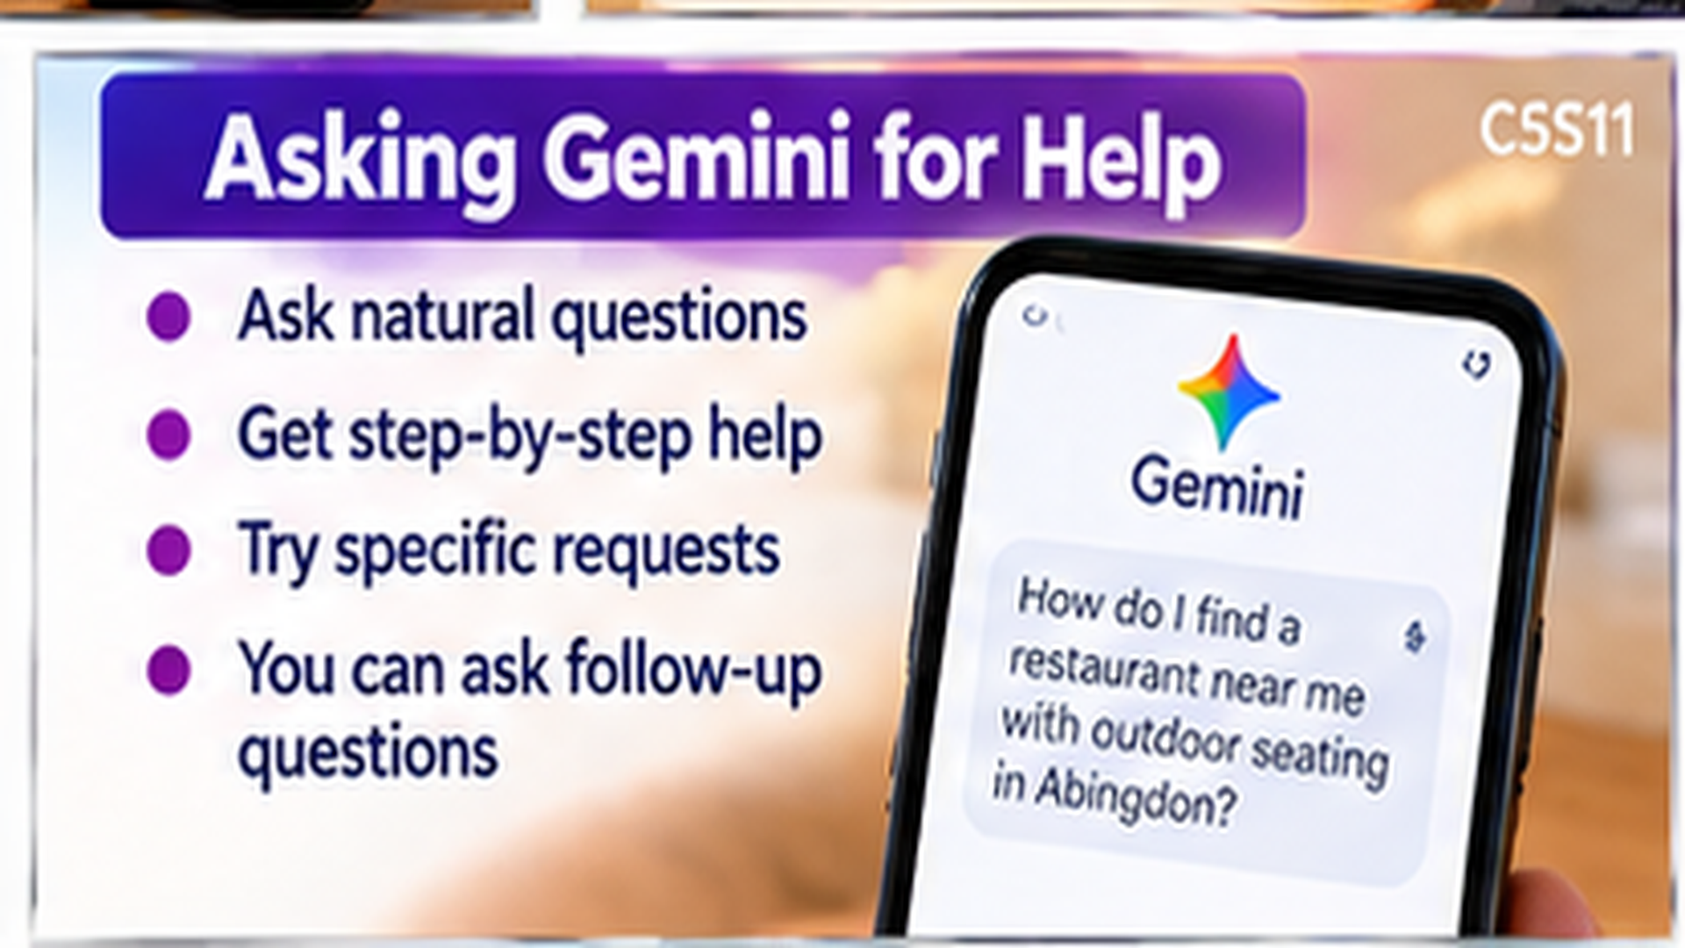
Asking Gemini for Help
• Name your phone and your problem
• Ask for one step at a time
• Tell Gemini if a step doesn't match
C5S11

Slide 12
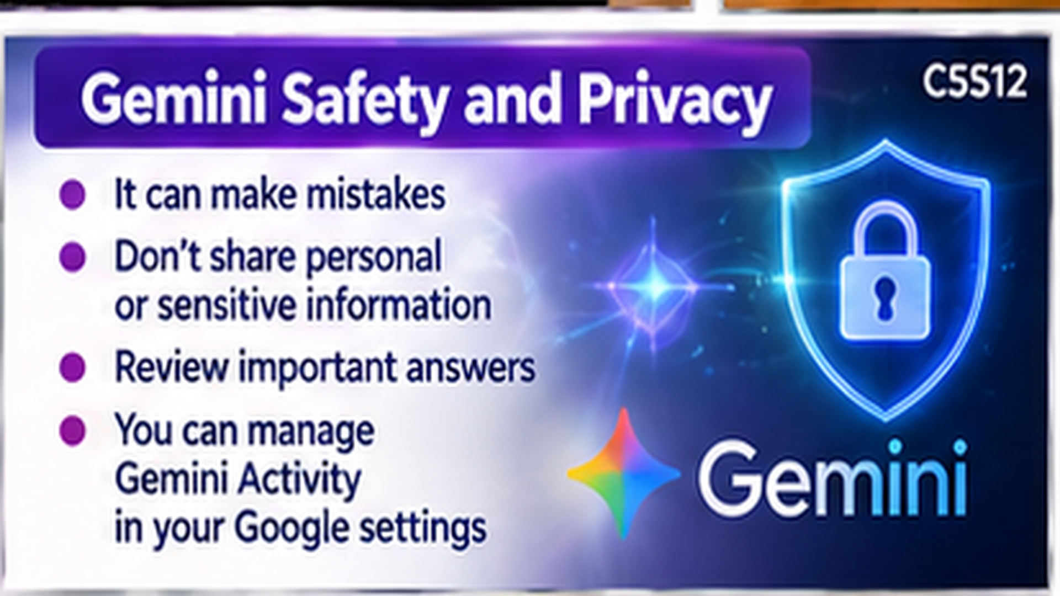
Gemini Safety and Privacy
• Gemini can make mistakes
• Don't share passwords or sensitive details
• Review Gemini Activity settings
C5S12

Slide 13
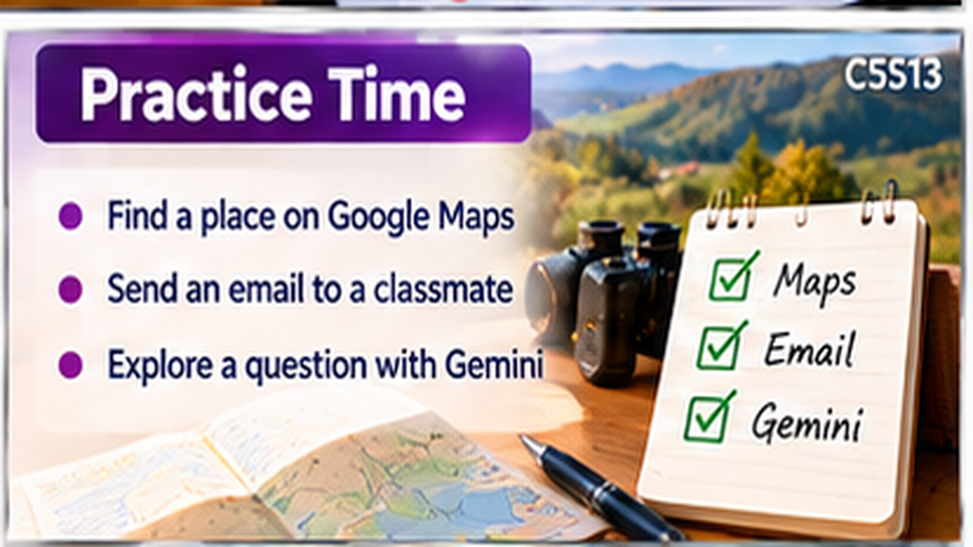
Practice Time
• Plan a route in Google Maps
• Send and reply to an email
• Ask Gemini a question about your phone
C5S13

